Slide 1
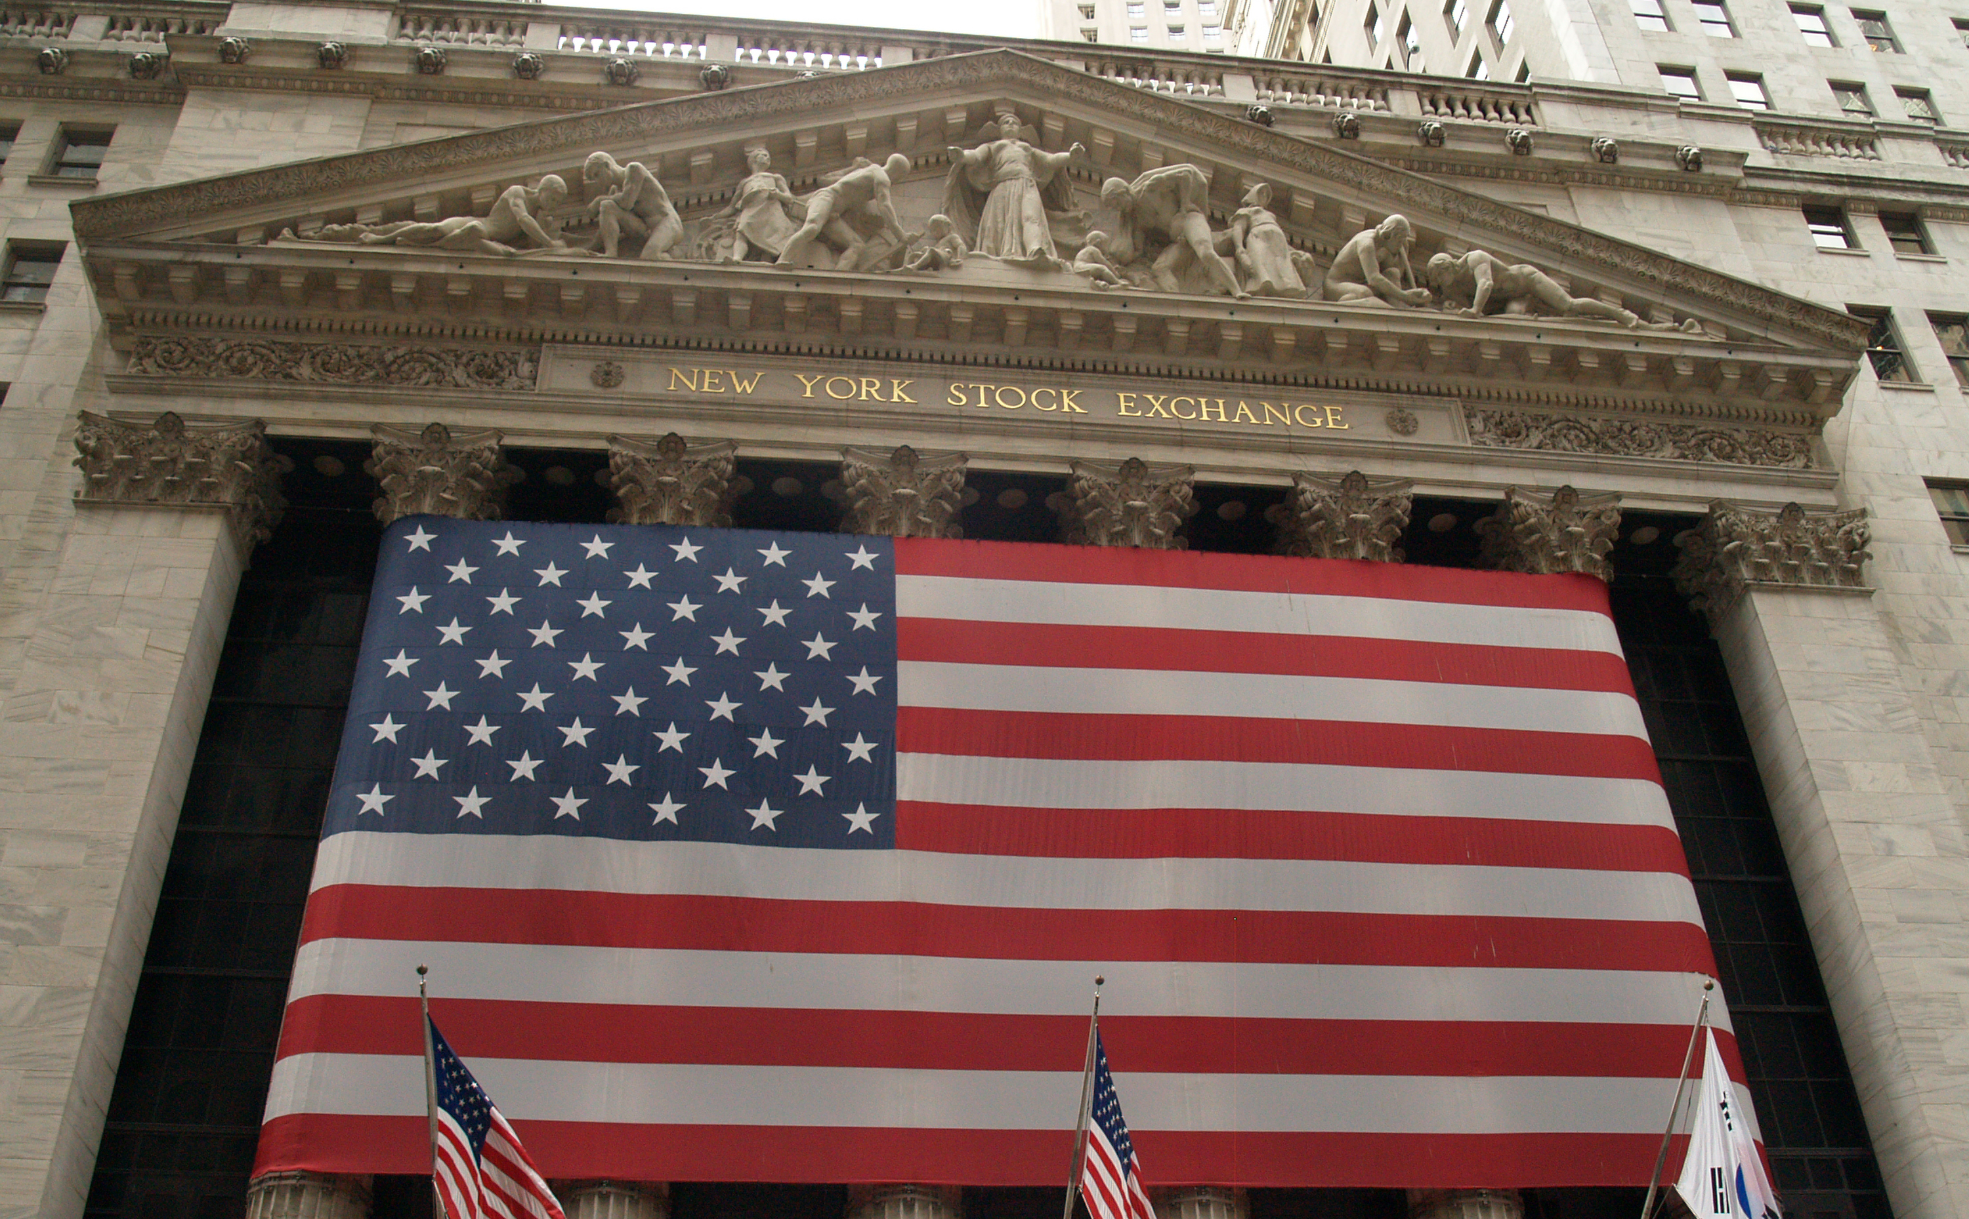
Timing the Stock Market with Congress
NYC Data Science Academy – R Project
February 24th, 2023
Brian Ralston
Notes:
­­­­Thank you for your time, and welcome to my presentation: ”Timing the Stock Market with Congress”
For my presentation, I chose to look at a dataset that tracks the financial transactions of members of Congress, including their stock trades, over the past 9 years..

Slide 2

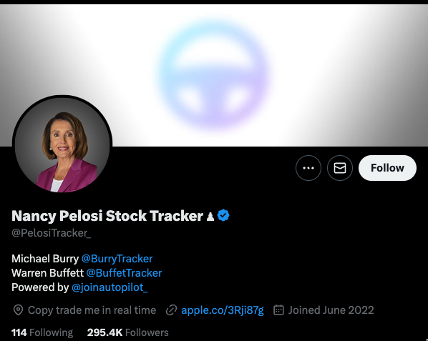
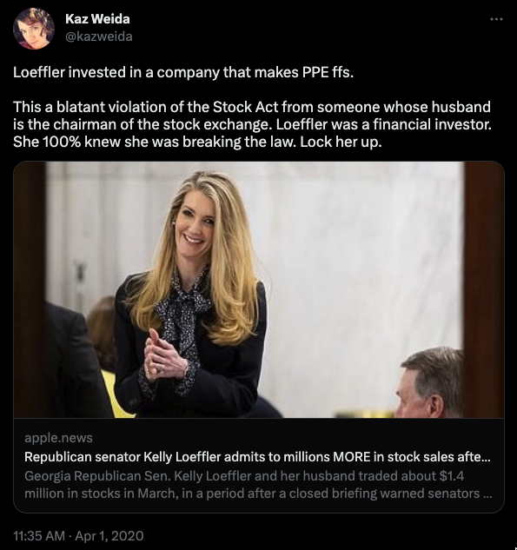
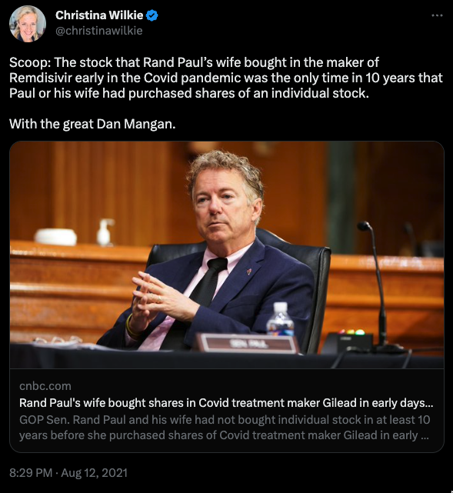
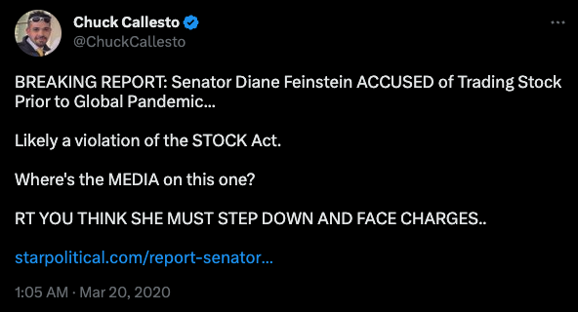
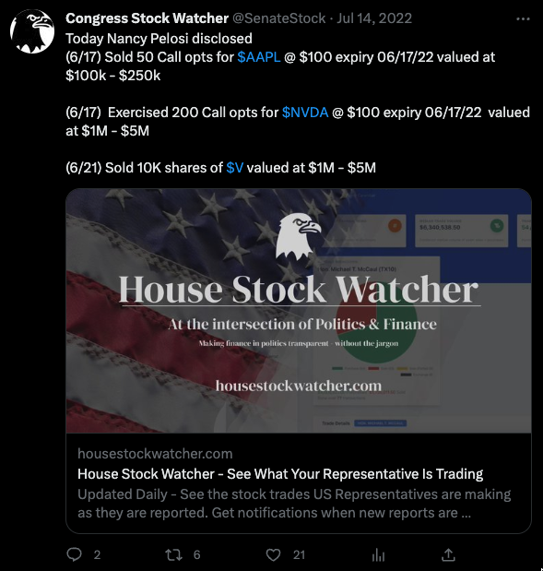
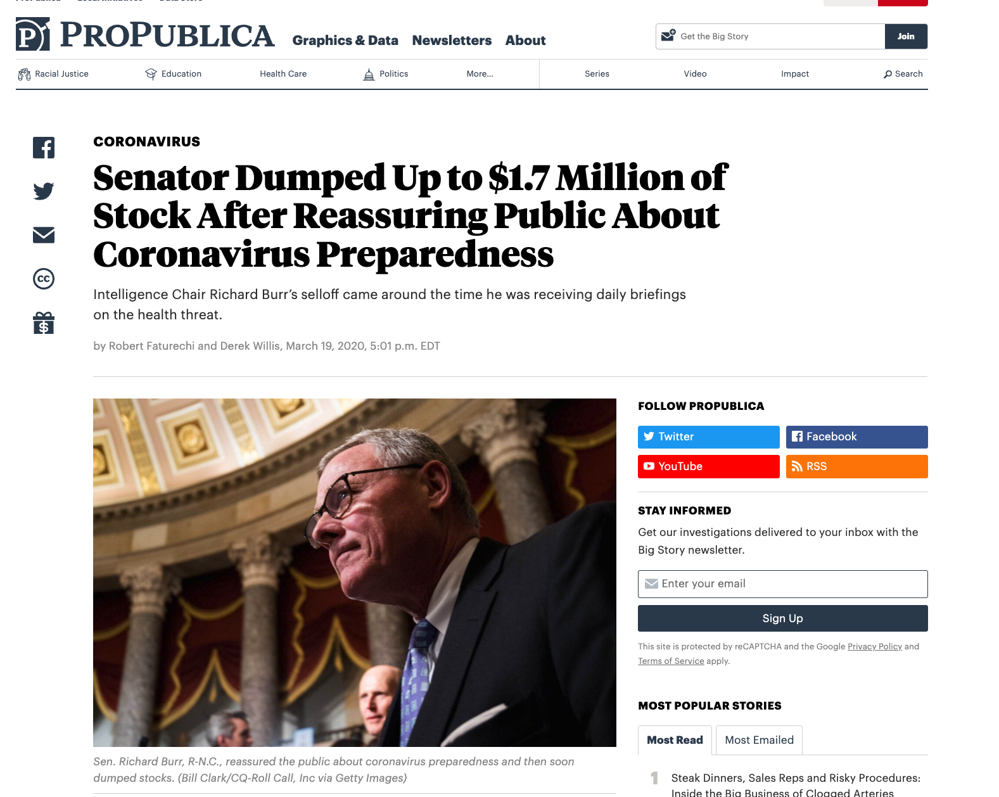
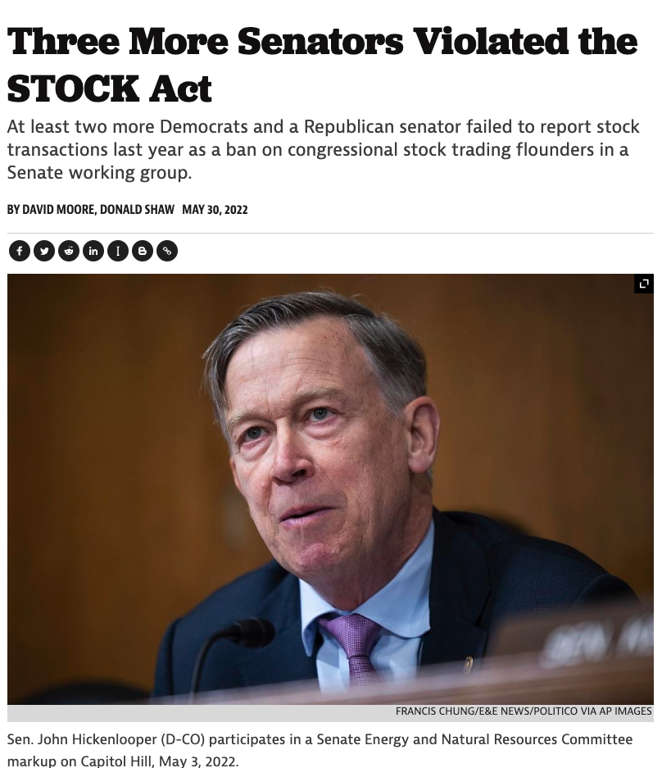
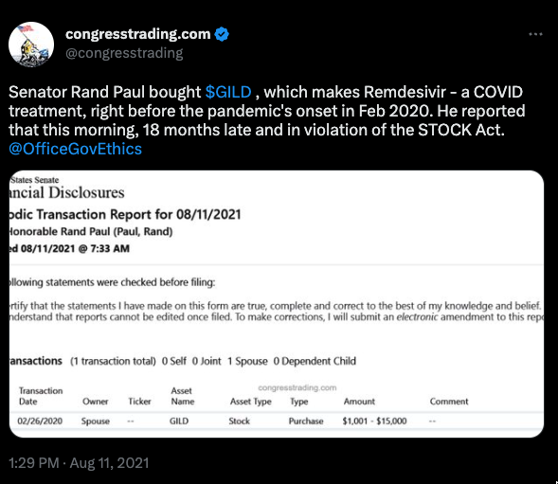
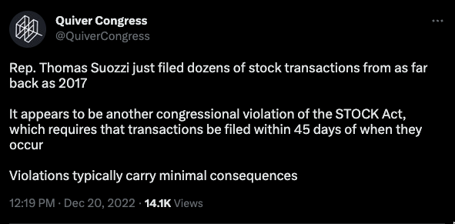
Notes:
Over the past few 3-4 years, there has been increased public scrutiny around insider trading in congress.
CLICK
There is a huge conflict of interest of being in that position of power and and having insight to so many aspects of society
It undermines public trust in their ability to serve the public interest.
This issue has been on my radar since March 2020 when many senators including Richard Burr, Kelly Loeffler, and David Perdue, were being called out for making trades with potential insider knowledge.
…
but it started to interest me once I realized that investors were actually using these reports to weigh Their decisions in what stocks to buy and sell.
Since this information was public, and the senators weren’t following the rules very well, and being pretty blatant about it as well,
CLICK
Investment advisors and social media influencers capitalized on this information..
Influencers online started touting these reports as cheat sheets for some quick money. Twitter accounts like Pelosi tracker started popping up (which currently has 250k follower) sending out alerts when Pelosi would file one of these reports.

Slide 3
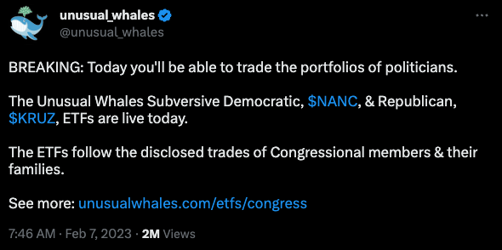
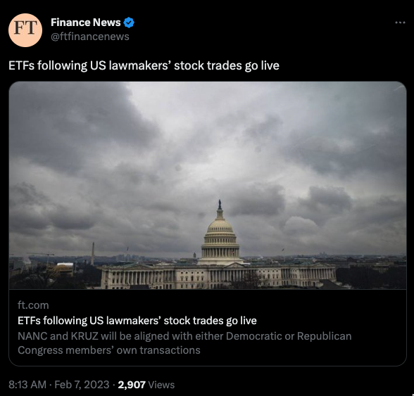
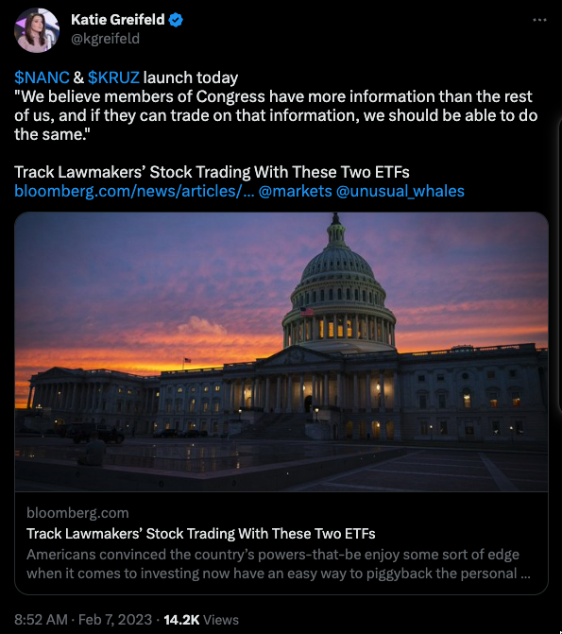
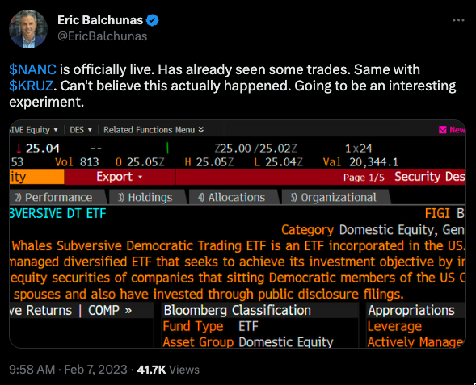
Notes:
This type of news gained so much traction, that two ETF’s just started trading on the market the other day on February 8th 2023
The ETFs NANC and KRUZ (Named after Nancy Pelosi and Ted Kruz) are a joint effort between investment firm, Subversive Capital, and equity data platform, Unusual Whales.
The ETFs buy and sell securities based on an analysis of the Financial Transaction Reports submitted by the congress members, and are separated into Democratic (NANC) and republican (KRUZ) tickers.
Both funds are actively managed and carry a hefty annual fee of 0.75%

Slide 4

Notes:
So…How did this situation come about?
…
People looking into this have spent a massive amount of time breaking down these reports through investigative journalism, extensive online crowdsourcing efforts.., etc.
Politicians are not in office to make money, they are in office to serve their constituents and communities.
The New York Times did a MASSIVE investigative report recent;y on 97 congress members, showing conflicts of interest and suspicios trades. (https://www.nytimes.com/interactive/2022/09/13/us/politics/congress-members-stock-trading-list.html)
They took a team of 100 analysts and spent thousands of hours breaking this all down.
I Knew this type of data set was intruiging, but I don’t have that kind of time and resources like the NY Times to put together a case as to whether or not insider trading took place.
So with this project, I am not going to figure out WHO is an insider trader, or even try to pass any judgement.
I will leave that to the Standards and ethics committee to prosecute all these individuals appropriately…of which, not a lot has been done…

Slide 5
Congress’ Effectiveness…at buying stocks
Top Congress Traders
Notes:
What really interested me about this topic and was accessible for me to analyze as an individual, was the fact These reports need to be filed in a timely manner. Obviously not everyone follows that rule, but they are supposed to be filed within 45 days.
I aggregated these reports and look at which congress members are really good at trading stocks.
I mean, this is definitely a very unique opportunity.
In Theory…
A civilian, could get relatively timely alerts from a highly influencial person that has a proven track record of successful trades and some ethically questionable insider knowledge.
in come cases, A representative might even have more value to a civilian as a stock market “financial advisor”, than a government representative.
Regardless,
For the remainder of this presentation I would like to find out :
If congress is effective at trading stocks
Which Congress members, stand out as particularly good stock traders.

Slide 6
Congress
Notes:
First, I would like to investigate if the government as a whole. I want to examine the aggregate data and see if congress members average out a good return, or if they outperform the S&P500,
Afterwards, I’ll dive in deeper to some individuals that made some particularly well timed trades and see which government officials I should follow for stock advise.

Slide 7
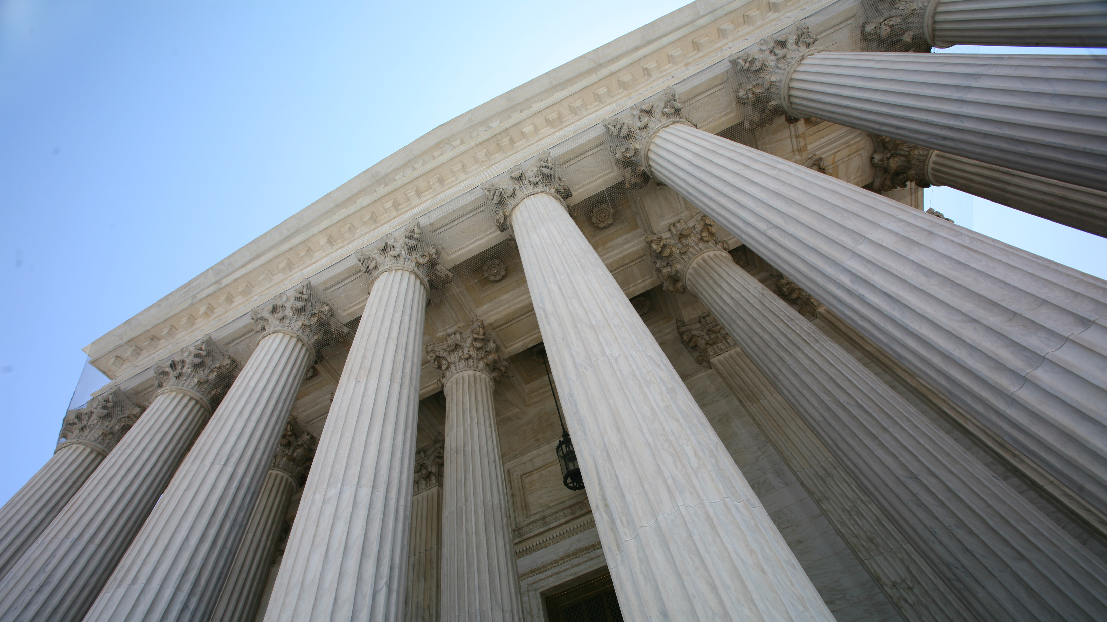
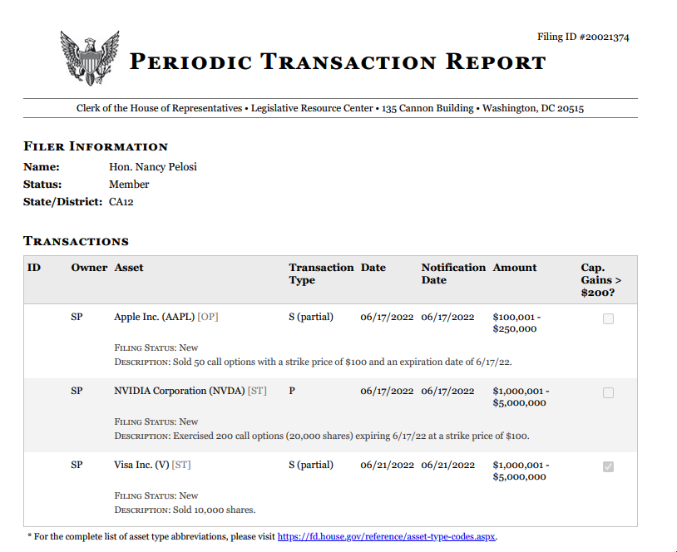
Notes:
So What are these reports that all of this is based on?
These financial disclosures are known as Periodic Transaction Reports (PTRs), and are a type of disclosure required by the STOCK Act of 2012. The STOCK Act requires certain government officials and employees, including members of Congress and their staff, to publicly disclose their financial transactions within 45 days of the transaction. These reports are then made publicly available through the Clerk's website.
The purpose of PTRs is to increase transparency and reduce the risk of conflicts of interest among government officials. By requiring timely disclosure of financial transactions, the public can see if an elected official or government employee has made trades that could be influenced by their position or access to non-public information.
Like many government programs, they make it publicly available, but not easy to access.
The clerk’s office doesn’t offer the information aggregated in a csv, or have an api. Instead, they publish individual .pdfs of each and every submission
Despite the challenges, there are a few online communities that have taken these forms and created a database of the information for easier public access. For my project, I depended on the website https://housestockwatcher.com/api for their api which is maintained by Timothy Carambat
They have a community of people who review the .pdf’s daily and manually transcribe the data into this database.

Slide 8




Dataset Variables
Representative Name
Party/ Branch
State/District
Ticker Symbol and Sector
Disclosure Date
Transaction Date
Transaction Value Range
Buy or Sell
Gain >$200
Ticker Price from Trans Date
Price 7/30/90/365 days later
S&P500 Price with same
Notes:
There is a vast amount of information to analyze, with approximately 22,000 transactions filed in the Periodic Transaction Reports. From these reports, I was able to collect the following data points:
Name of the Congress member, What Party they are in, what branch of the government, and what state/district they represent
The name of the stock that was bought/sold, the Date of transaction, and the date that it was disclosed to the public
Range of value of the transaction, what type of transaction it was, and if it was sold for a profit over $200
I then Appended the collected data with some separate data.
I Scraped Yahoo Finance for all of the tickers that congress members traded over the past 9 years.
I then Appended the adjusted close price of that stock to the data frame matching it by transaction date
I additionally appended the price of that same stock, 7, 30/90/365 days later to have a comparision to the original purchase or sell price of the stock.
I also appended the S&P500 so that the representatives trade could be compared to it.
Lastly, it is important to note what I cannot gather from this information.
The exact amount of stocks traded is not available, nor is the exact USD value or number of stocks traded.
As a result, it is not possible to accurately recreate each representative's stock portfolio or determine what they held before filing these reports.

Slide 9
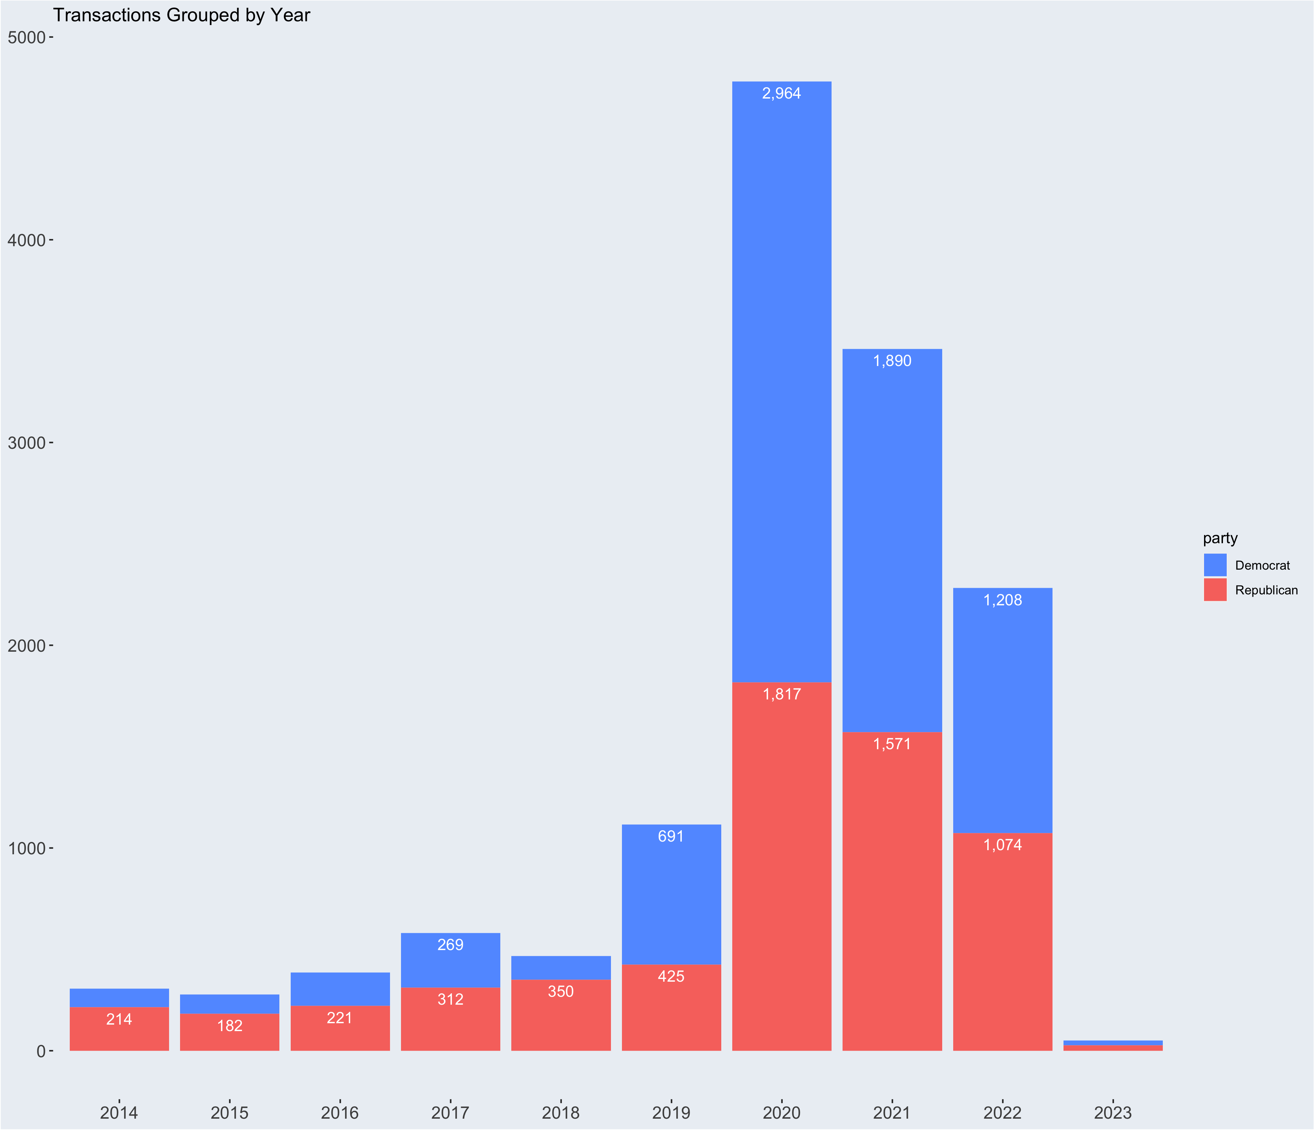
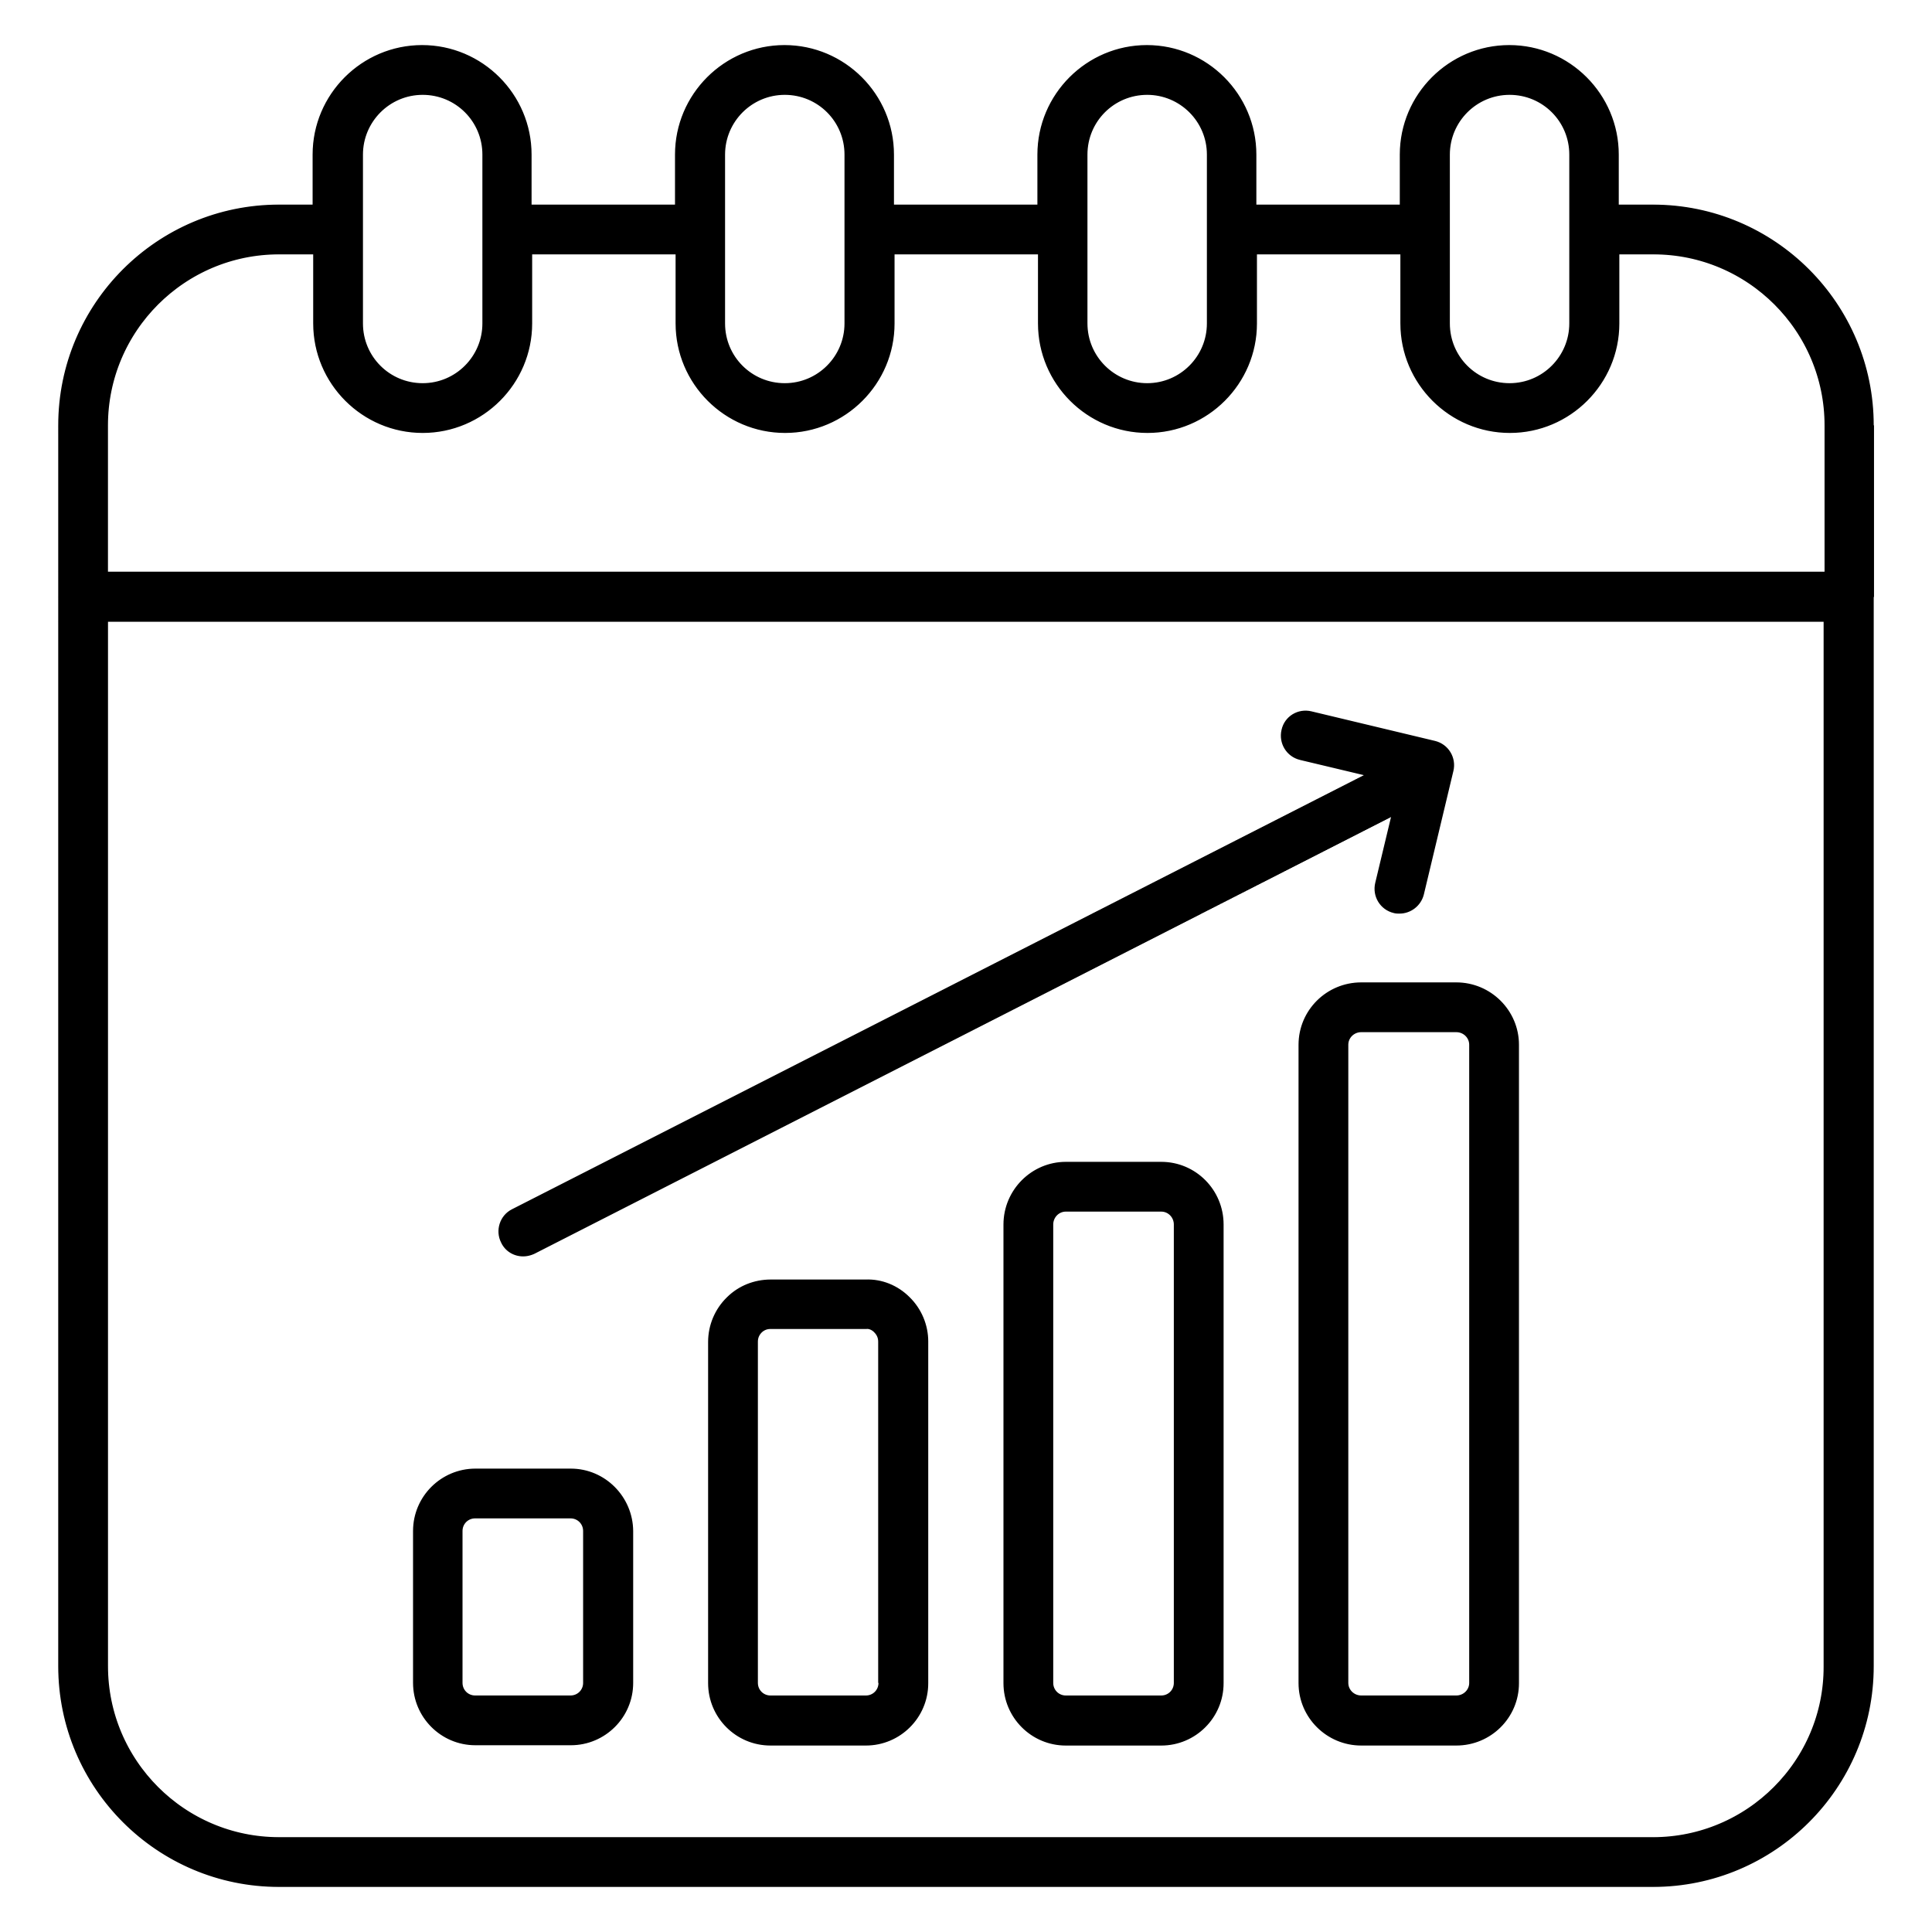

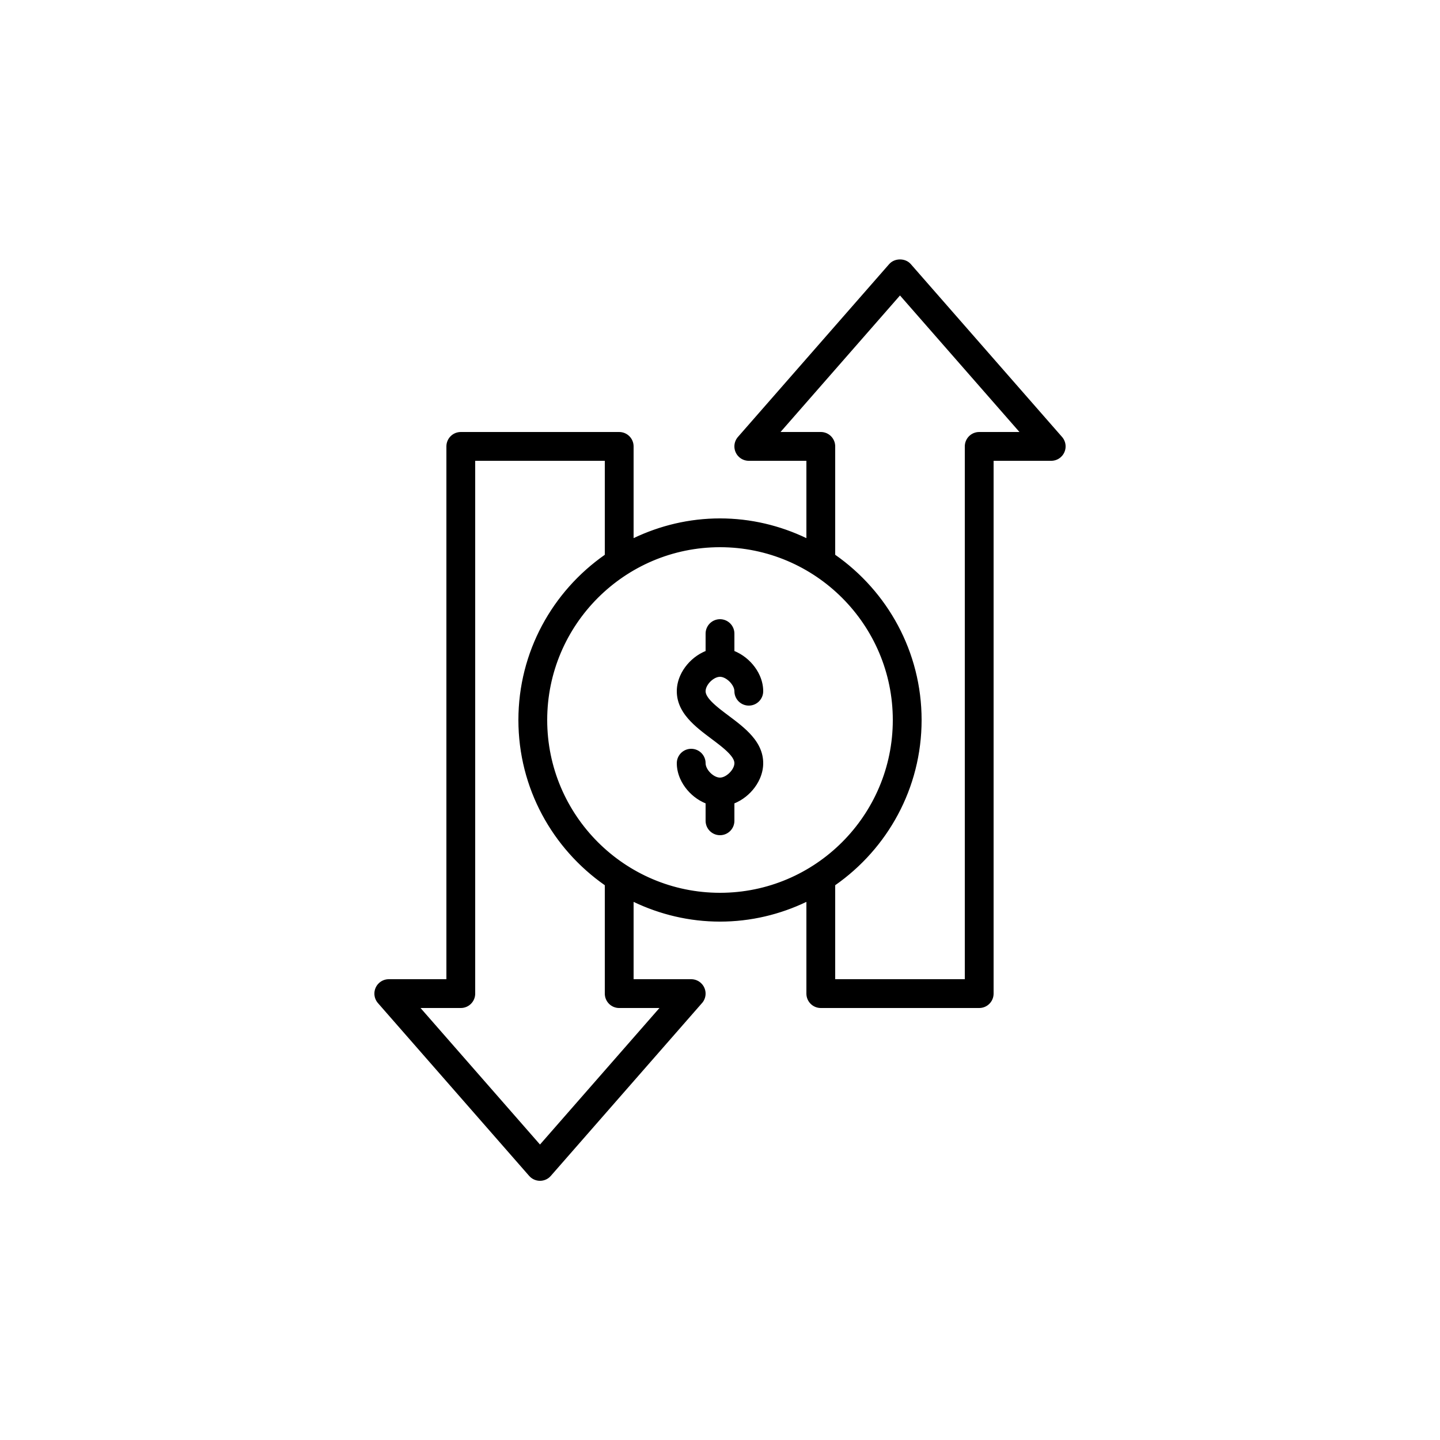

Data Summary
2014 – 2023
Avg: 12 Trades/day
Max/day: On 3/18/20 - 255 Trades
16,430 Trades
8,793 (D)
7,591 (R)
Trade Count
Range: 1 – 1,050
Avg: 82.6 Trades
Median: 17
$1k – $25M
Avg: ~$22k – $80k
Median: $1k – 15k
13% of Sell Trades
>$200 Gain
Notes:
After cleaning up the data, I was able to match around 16,000 valid ticker transactions with scraped stock prices from Yahoo Finance. The observations took place from January 31, 2014, to February 6, 2023, with an average of 12 trades per day and a maximum of 255 trades in a day on March 18, 2020.
Out of these 16,000 transactions, 8,793 trades were made by Democrats, and 7,591 were made by Republicans. When grouping the data by individuals, representatives made as few as 1 trade and as many as 1,050 trades throughout this time period. The average congress member traded 82.6 times, and the median number of trades was 17, implying a distribution curve skewed to the left.
The transactions themselves ranged from the minimum amount for reporting, which is $1,000, all the way up to a $25 million trade made by Senator Susan Collins from Maine, where she bought $25 million worth of the company 3M on March 3, 2015. The average transaction range was from $22,000 to $80,000, and the median transaction was in the $1,000 to $15,000 range.
The graph accompanying this slide likely shows the distribution of transaction values, which could help identify any outliers or patterns in the data. Additionally, the slide mentions that only 13% of reported sell transactions were sold for a gain, which could suggest potential investment strategies or insights.
TALK ABOUT THE graph

Slide 10
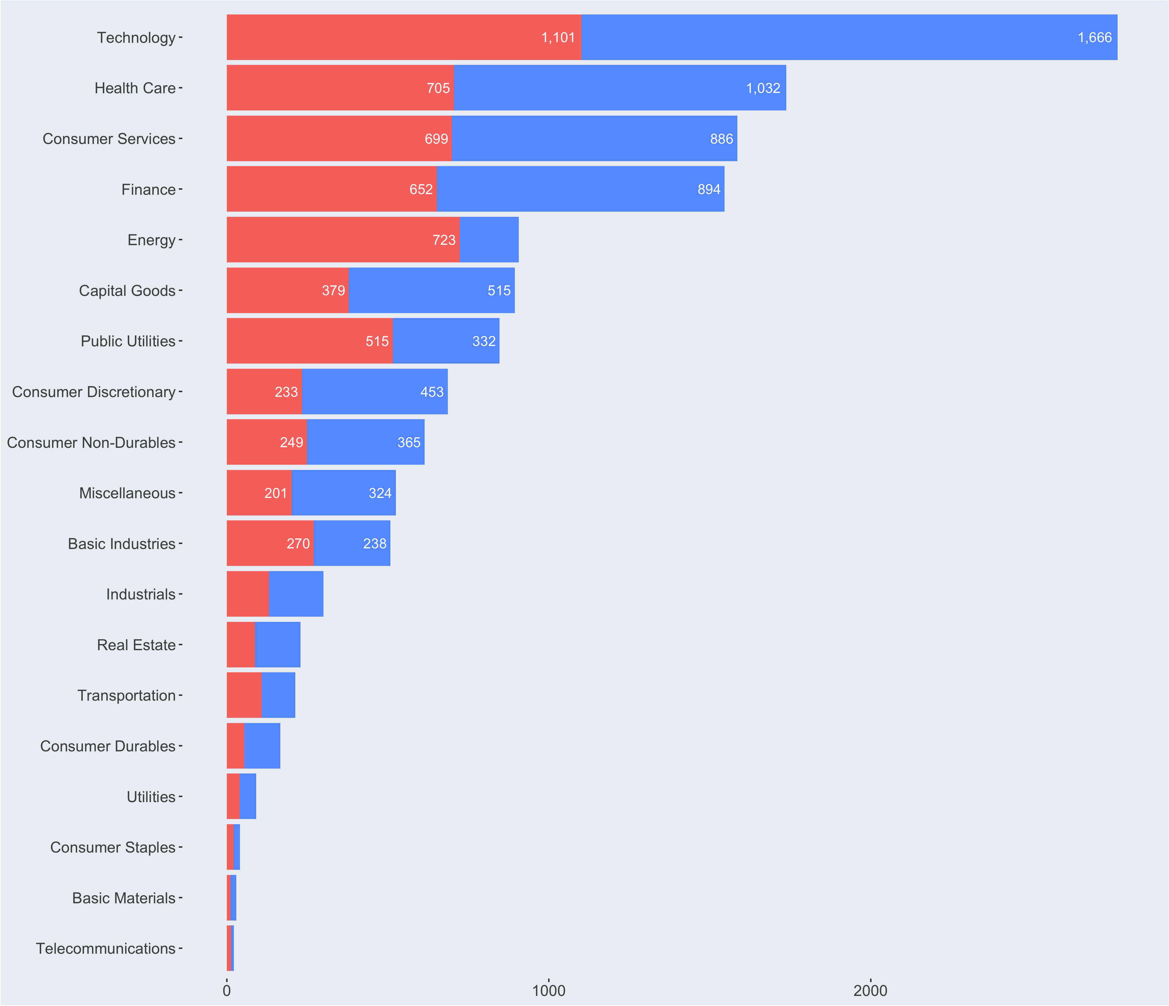
Sectors
Notes:
After cleaning and analyzing the data, I created a graph to group the transactions by sector of the stocks traded.
The graph shows that tech stocks like Apple, Alphabet (Google), and Facebook are popular among both Republicans and Democrats.
However, healthcare, finance, energy, and public utilities are also high on the list, indicating that representatives feel more confident in those sectors than others.
These sectors align with quite a few congressional committees and therefore this may be the result of insider knowledge coming from committees etc., but there is no way to know with out doing a thorough investigation.
Another insight from this graph is the breakdown of Republicans vs Democrats.
Interestingly, Republicans are shown to be more interested in energy stocks than Democrats, along with public utilities and "basic industries."
On the other hand, Democrats traded more frequently overall in other sectors, which may be partially explained by the fact that democrats made 800 more transactions than republicans.
This graph provides valuable insights into the trading behavior of different parties and their focus on specific sectors.
NEXT

Slide 11
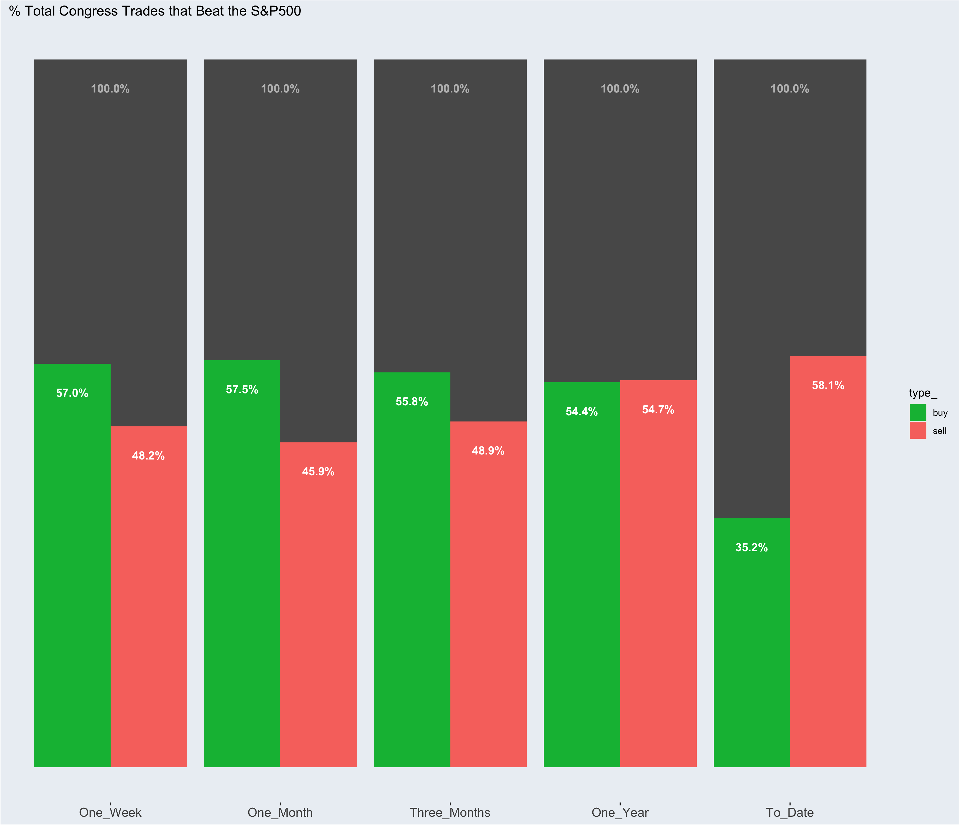
Congress vs. S&P 500
Notes:
So now that I've given you a summary of the dataset, let me walk you through how I analyzed the performance of Congress.
I was particularly interested in figuring out if Congressmembers are good at timing the stock market.
Since I only had a range of values for each transaction and not exact amounts, I decided to look at the transaction date and the ticker associated with each trade.
Then, I added the value of that ticker for various time frames after the transaction date, including 7 days, 30 days, 90 days, 365 days, and the current date.
After that, I calculated the percentage change between the price of the stock at the time it was traded and the price of the stock in the time frame after the transaction.
This helped me determine whether Congressmembers were buying stocks that performed well after their purchase or if they were selling stocks that performed poorly after they sold them.
CLICK
On this graph, you can see the percentage of government trades that have outperformed the S&P 500.
The x-axis groups the trades by the time frame of the percentage change.
Overall, it appears that Congress has roughly a 50% chance of their trades beating out the S&P 500.
However, in the time frame of 1 year or less, more than 50% of Congress's transactions outperformed the S&P 500.
In the longer term, however, only 35% of Congress's trades outperformed the S&P 500 when they purchased a stock.

Slide 12
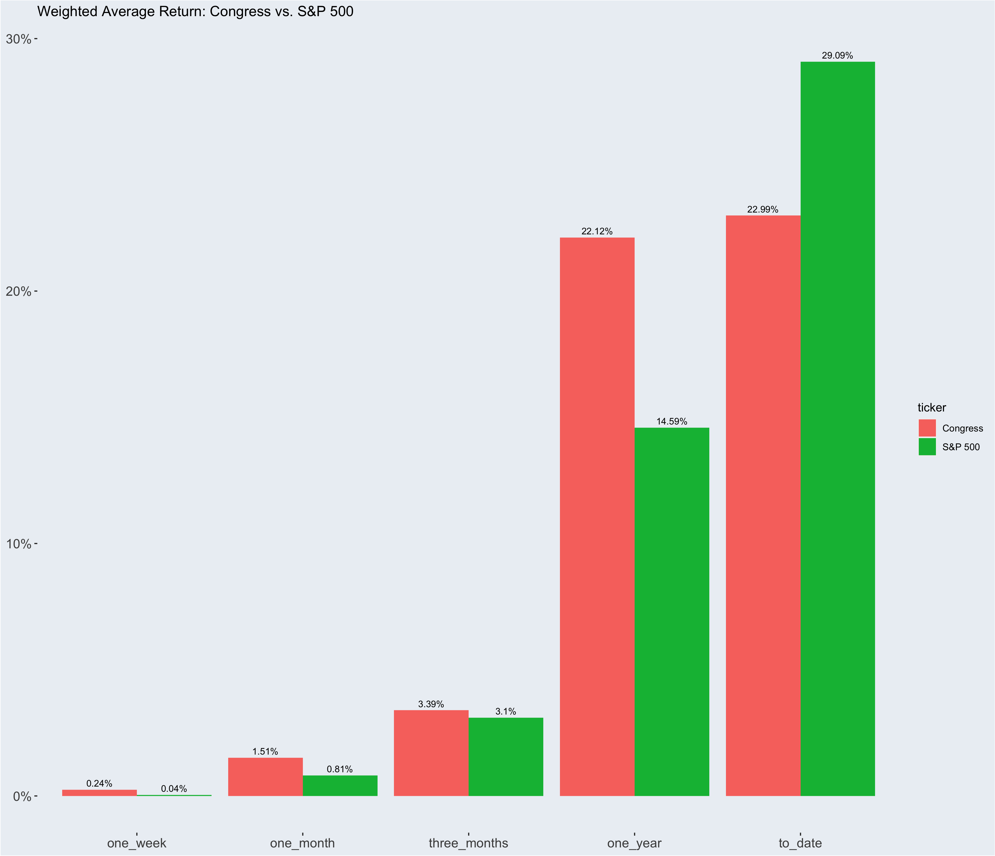
Average Return
Notes:
Alright, so in this graph, we're comparing Congress to the S&P 500 to see who's better at timing the market.
And it looks like, overall, Congress beats out the S&P 500, except for the "to_Date" time frame.
This reminds me of a famous finance tale about Warren Buffet and a hedge fund in the late 2000s.
Buffet made a bet that over 10 years, a simple S&P 500 ETF would beat out any strategy that the hedge fund managers could come up with.
In the short term, the hedge fund was the clear front-runner, especially with the 2008 financial crisis.
But in the end, it was a classic story of the tortoise and the hare, with the ETF returning 85% over 10 years and the largest return of the 5 strategies the hedge fund put together being 62%, but averaging only 22%.
And a similar scenario is playing out here with Congress members buying stocks. On average (weighted based on volume), they're able to beat out the S&P 500 up to a year.
But past the year mark, if they had just bought and held to_date, they would have been better off buying the S&P 500.
But here's the thing: when it comes to timing the market, it's not always a good thing when the price rises.
If you buy a stock and it goes up in the following month or so, that's a well-timed buy. But if you sell a stock and it rises in value in the months following, that's a poorly timed trade.
My chart currently doesn't consider transaction type as a factor, so let's break this up further by looking at whether the transaction was a buy or a sell.

Slide 13
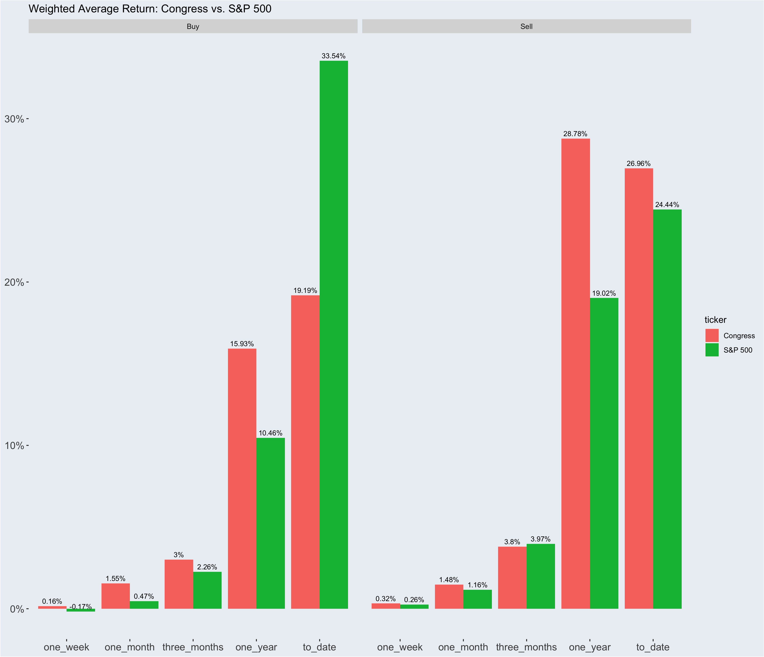


Notes:
On this slide, I've included a graph that breaks down the data by transaction type and political party.
The purpose of this chart is to provide a deeper analysis of the data to see which entity is better at timing the market for buying and selling stocks. Congress, or just the regular S&P500.
To interpret this chart, if the buy-percentage-change is higher than the other value, that means that entity outperformed the other.
Conversely, with the sell data, we are looking for a lower percentage change since stocks typically rise over time. In other words, the lesser number is the better number.
(TALK RESUTLS)
BUY SIDE
Click
SELL SIDE
SO: Overall here congress is good at timing BUYS and not as good a timing the sells, compared to the S&P 500.
In terms of timing the market with selling, the Government performed much poorer than then if they were holding the S&P and sold that.
The only time is when they beat out on average 3 months after the transaction date, every where else, the S&P500 rose less than the Gov trades.
However, I’m interested in an even FURTHER breakdown. I want to know if Democrats, or Republicans are better at timing the market.

Slide 14
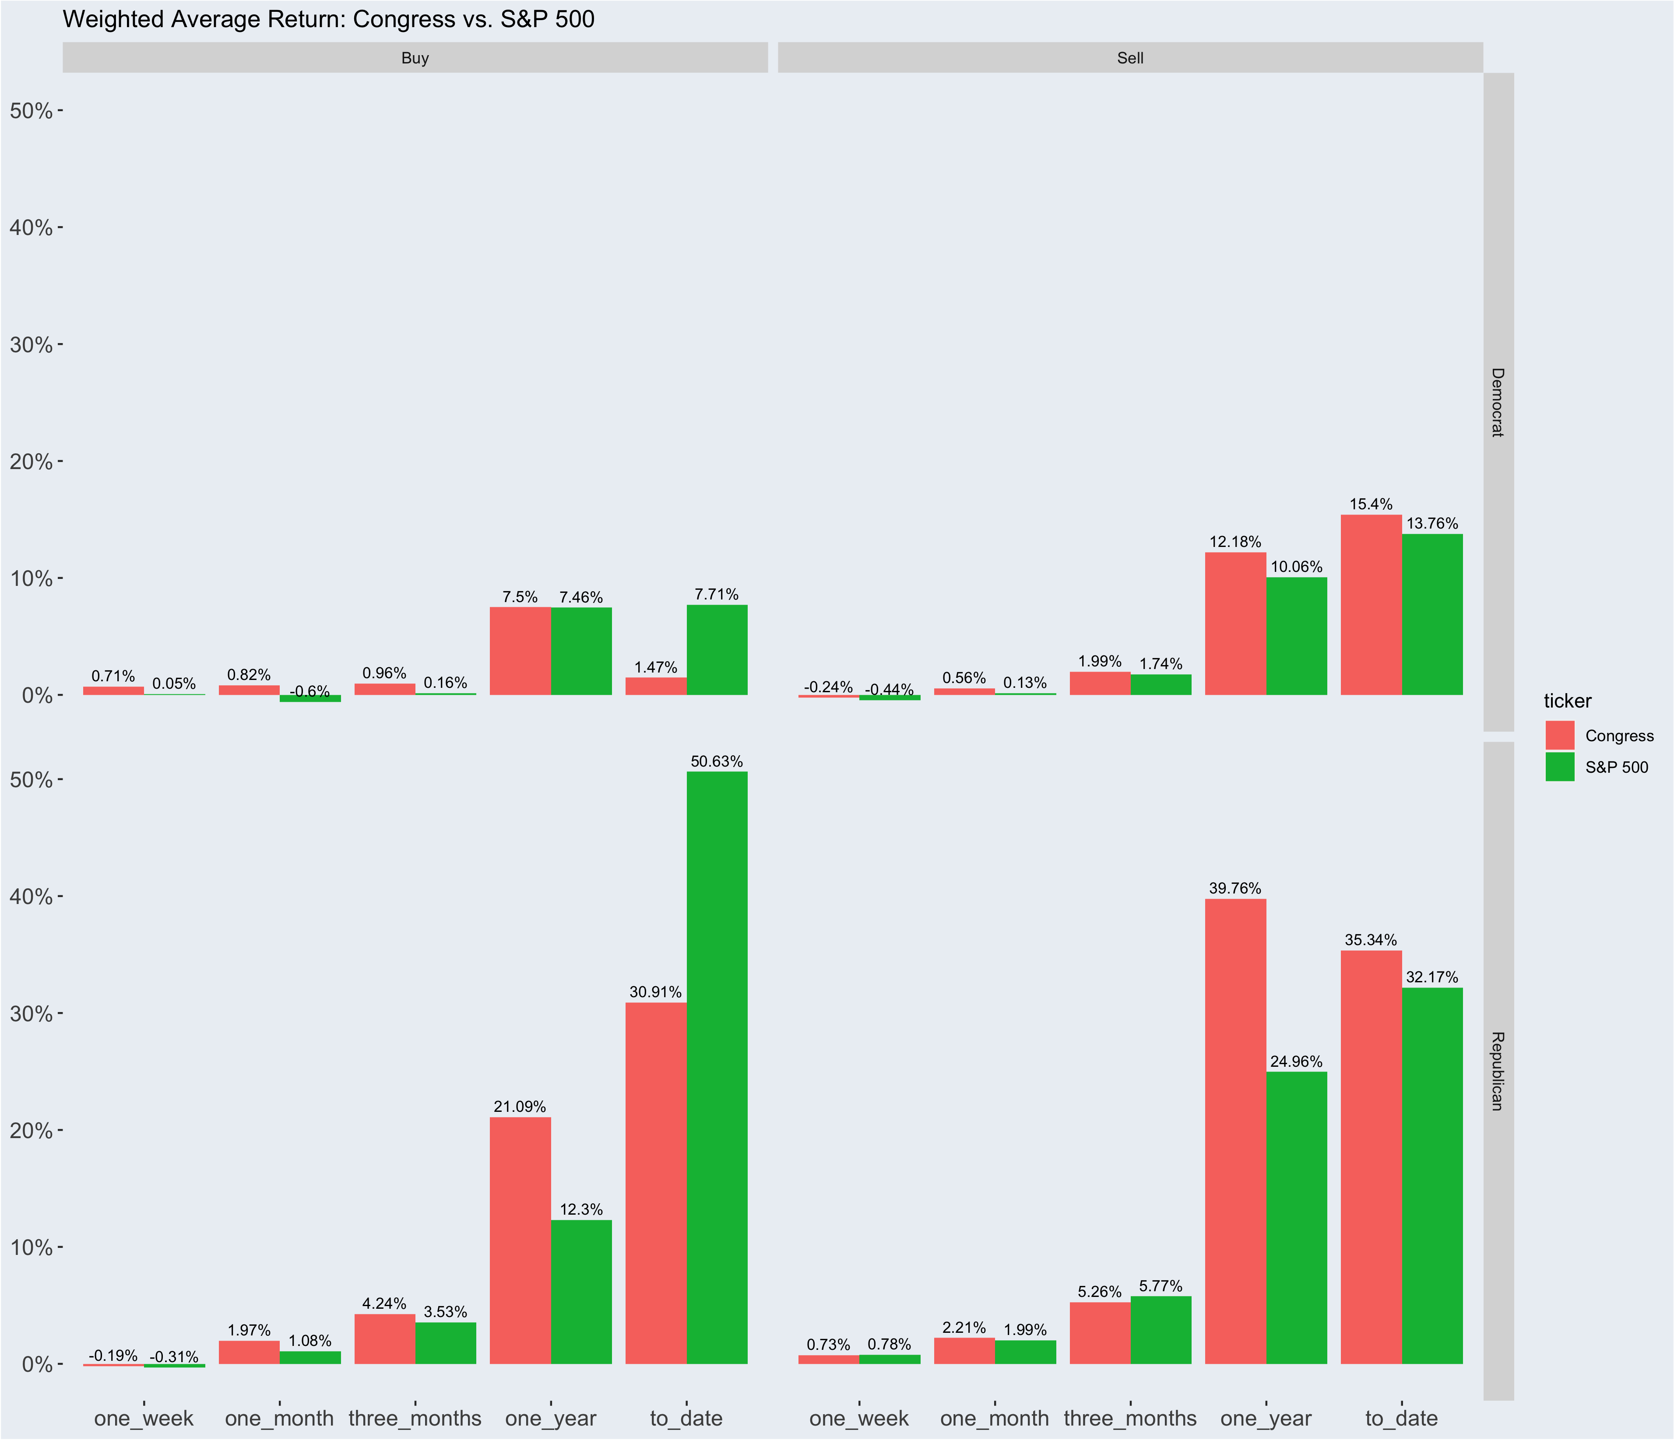
Notes:
Now let’s look at the sell transactions comparing democrats and republicans.
There is a MASSIVE Gap in performance between Democrats and republicans.
But the trends between the two are relatively similar as last time. In the buying Category, congress beats out the S&P 500, except in the to-Date category.
On this slide, I have included a graph that breaks down the data by transaction type and political party to analyze which political party is better at timing the market for buying and selling stocks.
The additional facet can be seen on the right-hand side of the graph, with Democrats on top and Republicans on the bottom. Buys are on the left, and sells are on the right.
What's surprising about this graph is the stark difference between Democrats and Republicans. Let's first compare their performance in the buying category.
CLICK
CLICK
The graph shows that Republicans outperformed Democrats in every metric, with the biggest difference being in the percentage change from transaction date to_date.
CLICK
CLICK
Now let's look at the sell transactions, again comparing Democrats and Republicans.
The difference in performance is massive, with the opposite of the above being true. Democrats consistently outperforming Republicans.
However, the trends between the two are relatively similar as last time. In the buying category, Congress beats out the S&P 500, except in the "to-Date" category.

Slide 15
Individual
Congress Members
Notes:
Now I am going to switch the focus from congress as a whole, to individual congress members to see which individuals are good at timing the market with their buys and sells.

Slide 16
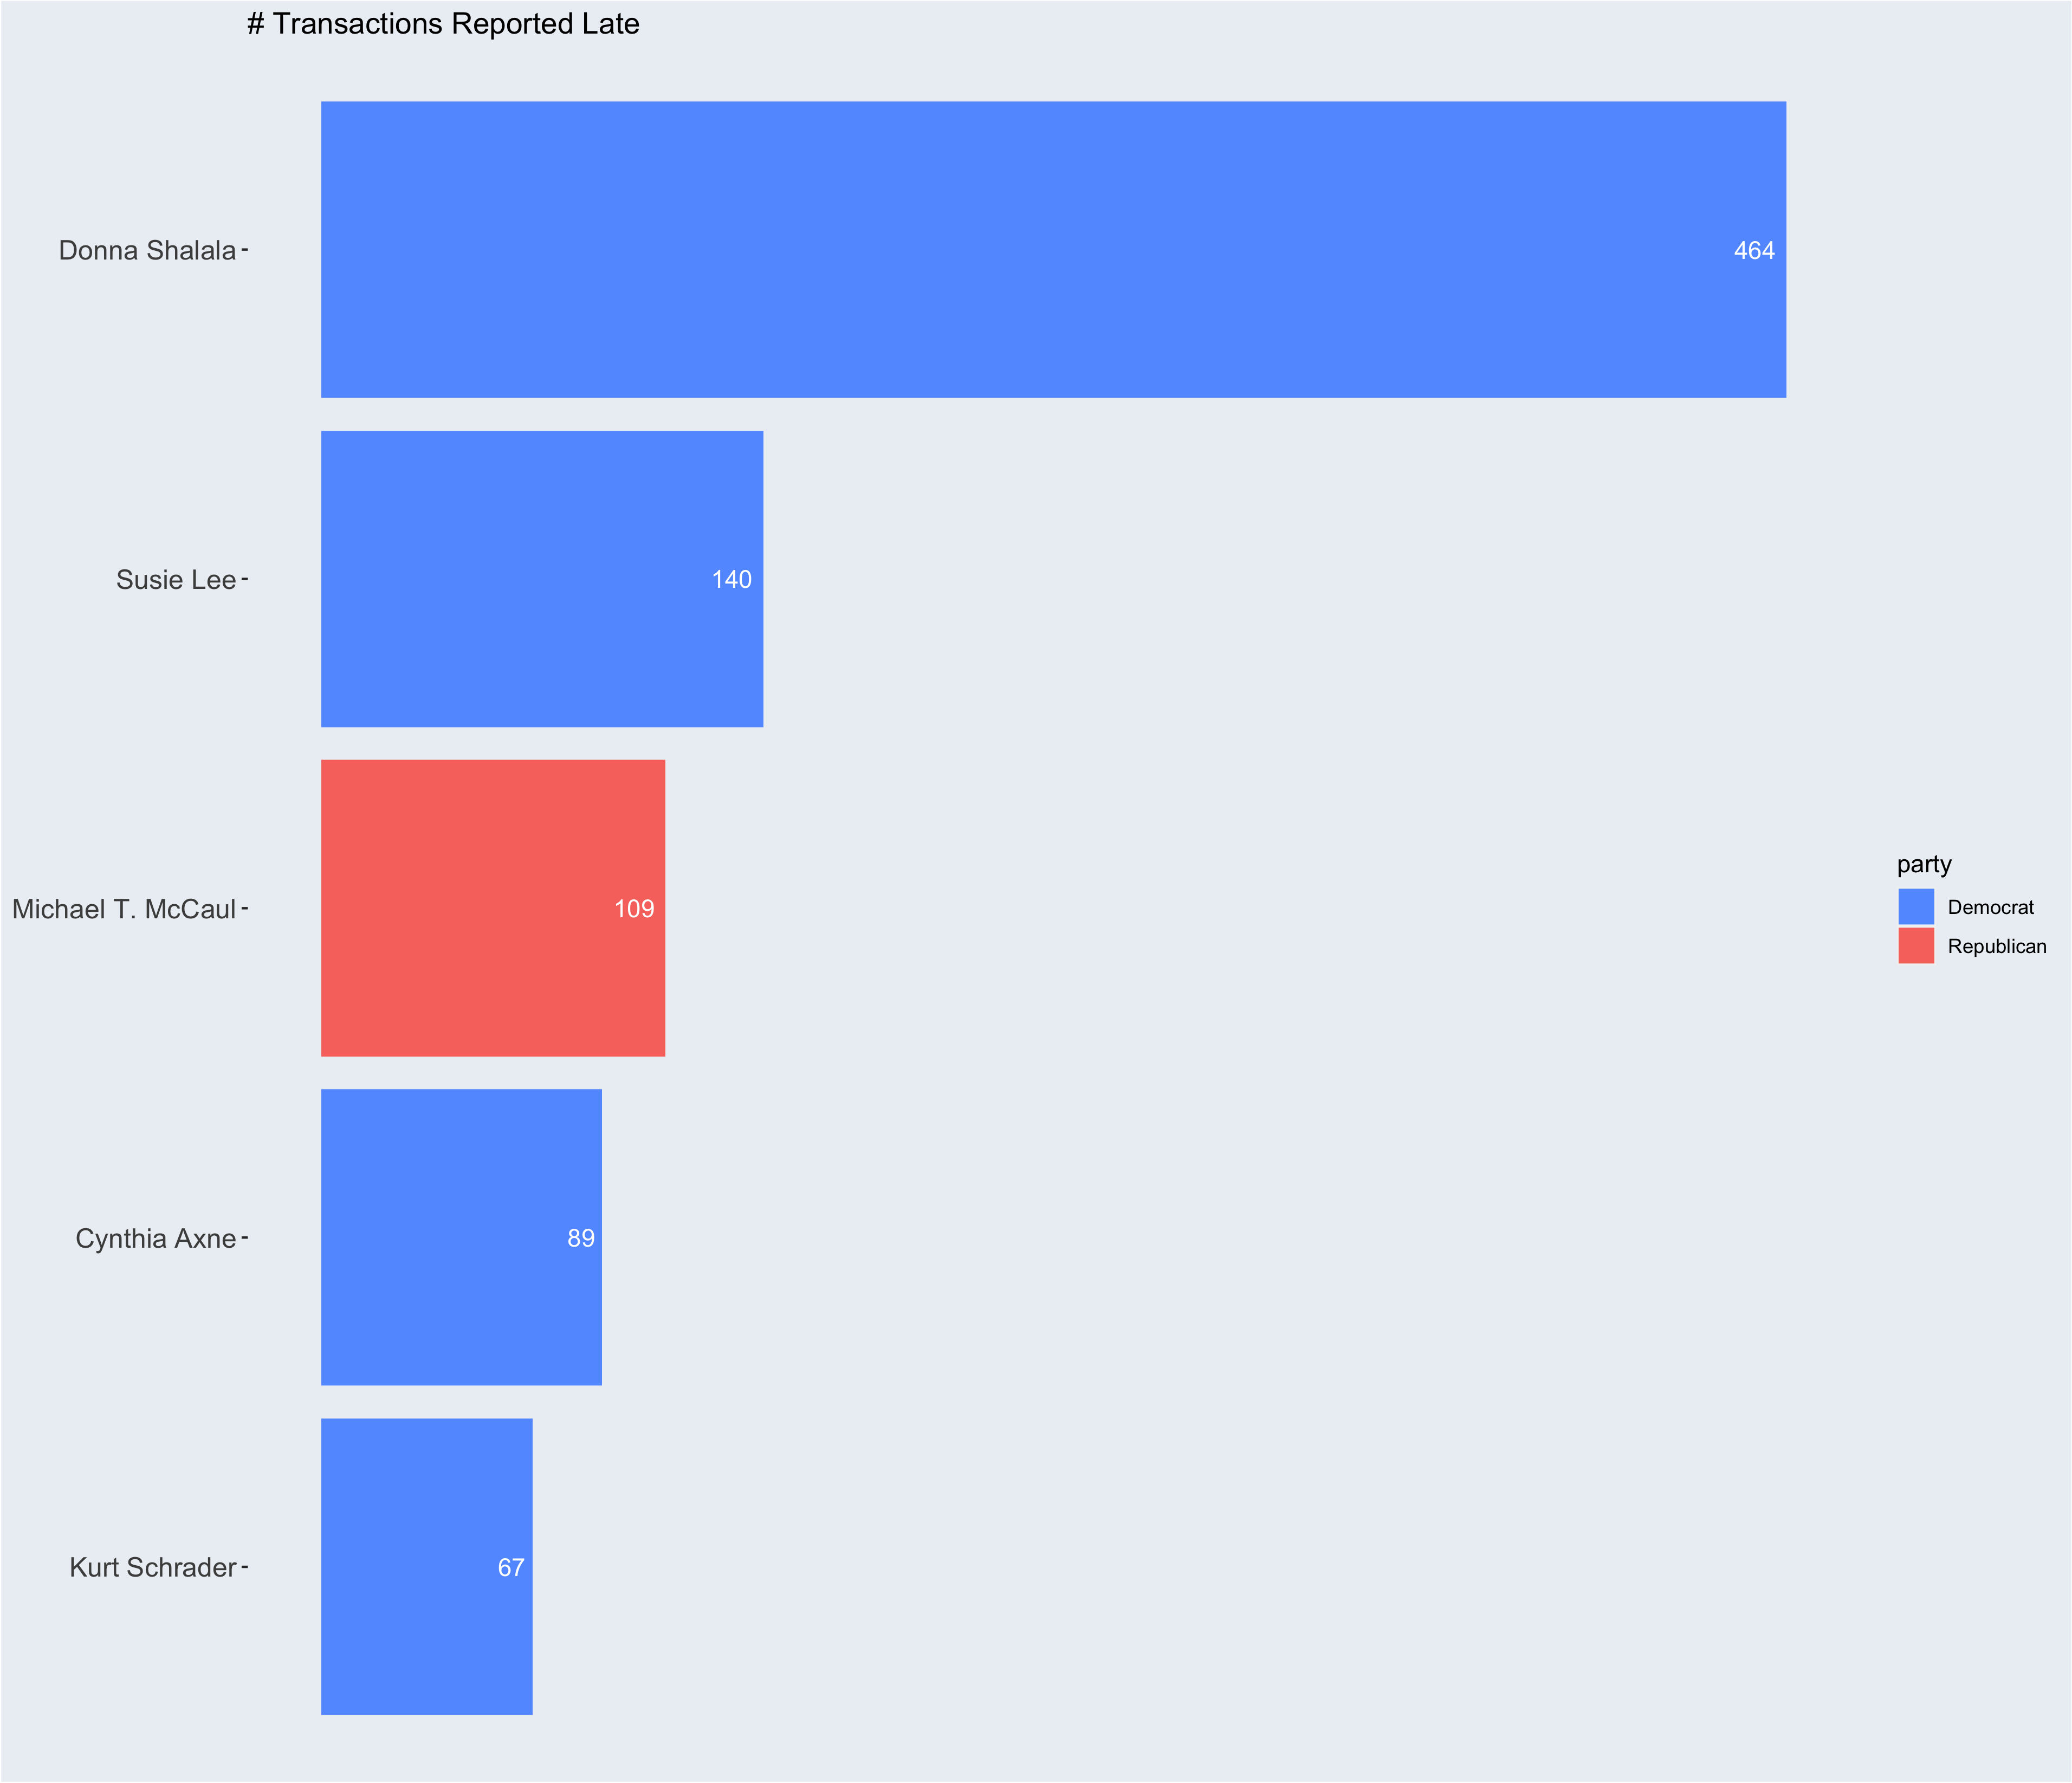
Reports Delayed (count)
Notes:
I’ll begin with who we should avoid for any sort of TIMELY advice. These are the top 5 people, who have the most transactions reported late. Donna Shalala, reported 464 transactions late. So timely advice is not her strong suite.
If I am looking for a source to rely on as a data point to in my decision on a stock purchase or sale, have this information 45 days late or more, will NOT really help me in the short term.
Representatives are required to report transactions before 45 days after the transaction. However, the average delay was 57.25 days, the max delay was 1640 days and the min delay was 1 day. There were 1,883 transactions and 85 representatives that reported late. Of those reps, the top 5 egregiously do not follow that rule. Of all 1883 transactions, NO ONE left a comment in the form saying why it was late. Only 375 used the comment part of the form anyway
https://www.businessinsider.com/congress-stock-act-violations-senate-house-trading-2021-9
In These particular Examples,
Donna Shalala Blamed it on an adcminstrative error, and was not fined. (https://thehill.com/homenews/house/494183-shalala-i-take-full-responsibility-for-failure-to-disclose-stock-sales/)
Susie Lee blamed them on clerical errors, and didn’t receive any fines. (https://nevadagop.org/icymi-rep-susie-lee-a-democrat-from-nevada-failed-to-properly-disclose-stock-trades-worth-as-much-as-3-3-million/)
Michael McCaul TX-R (It was mostly his wifes transactions that were reported late, and there were no fines)
Cynthia Axne IA-D: clerical error(https://www.desmoinesregister.com/story/news/politics/2021/09/23/watchdog-campaign-legal-center-wants-ethics-investigation-iowa-rep-cindy-axne-over-stock-trades/5827271001/)
Kurt Schrader OR-: No statement and no fine (https://www.businessinsider.com/congress-stocks-kurt-schrader-oregon-2022-2)
Members of Congress face a $200 fine for failing to disclose their stock trades on time, but the Committee on House Ethics does not assess a fine for first-time STOCK Act disclosure provision violators if they're late by 30 days or fewer. Schrader's late stock disclosures fell within this "grace period," meaning he will avoid a fine.

Slide 17
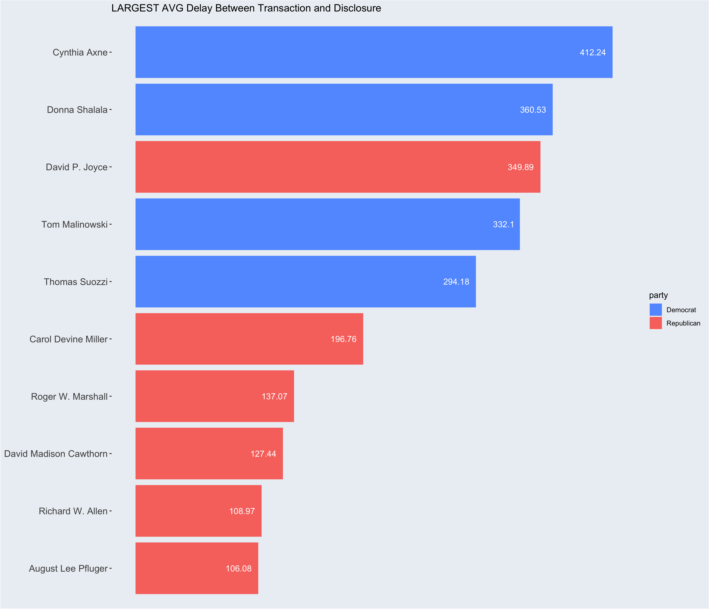
Largest Average Delay (days)
Notes:
Here are some additionaly folks that should not be relied on for timely advice. These members all had average reporting delays of 100+ days!
NEXT

Slide 18
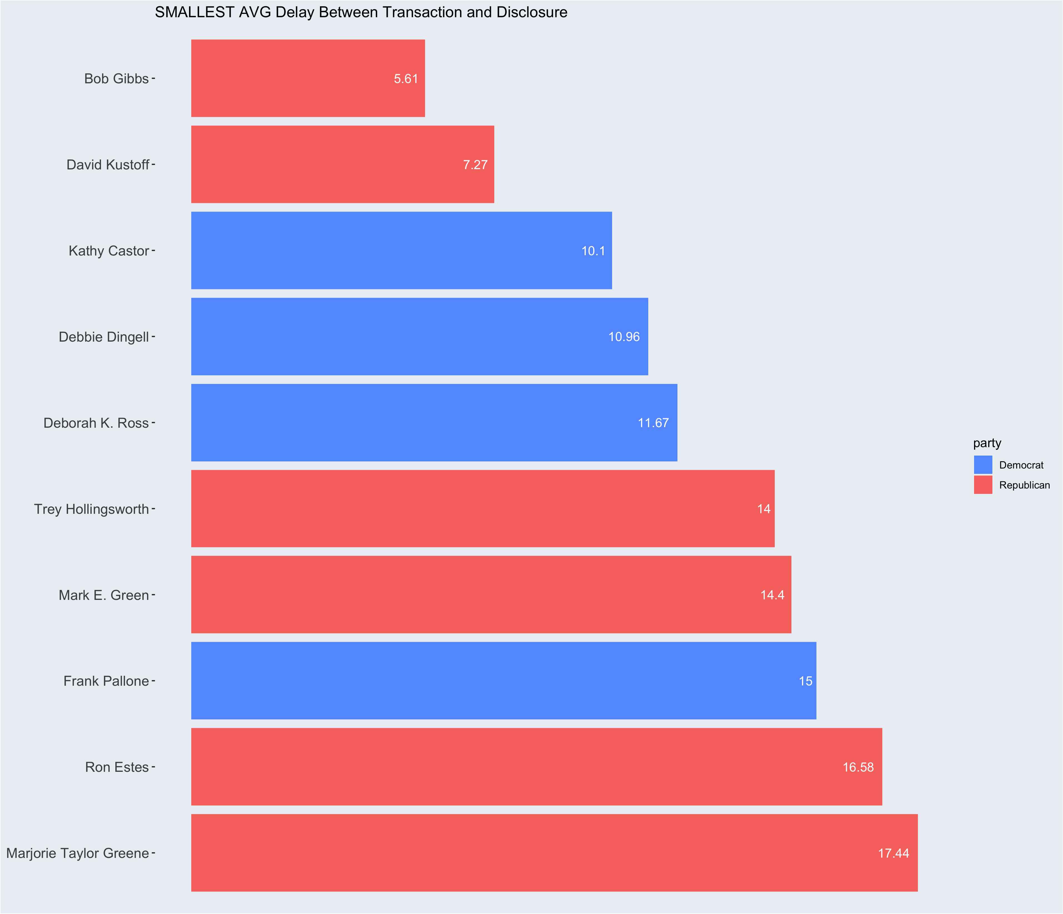
Smallest Average Delay (days)
Notes:
Conversly, Here are people that we can rely on for timely advice. Everyone here has an everage delay of reporting of less than 18 days, with the top average being 5.51 days.

Slide 19
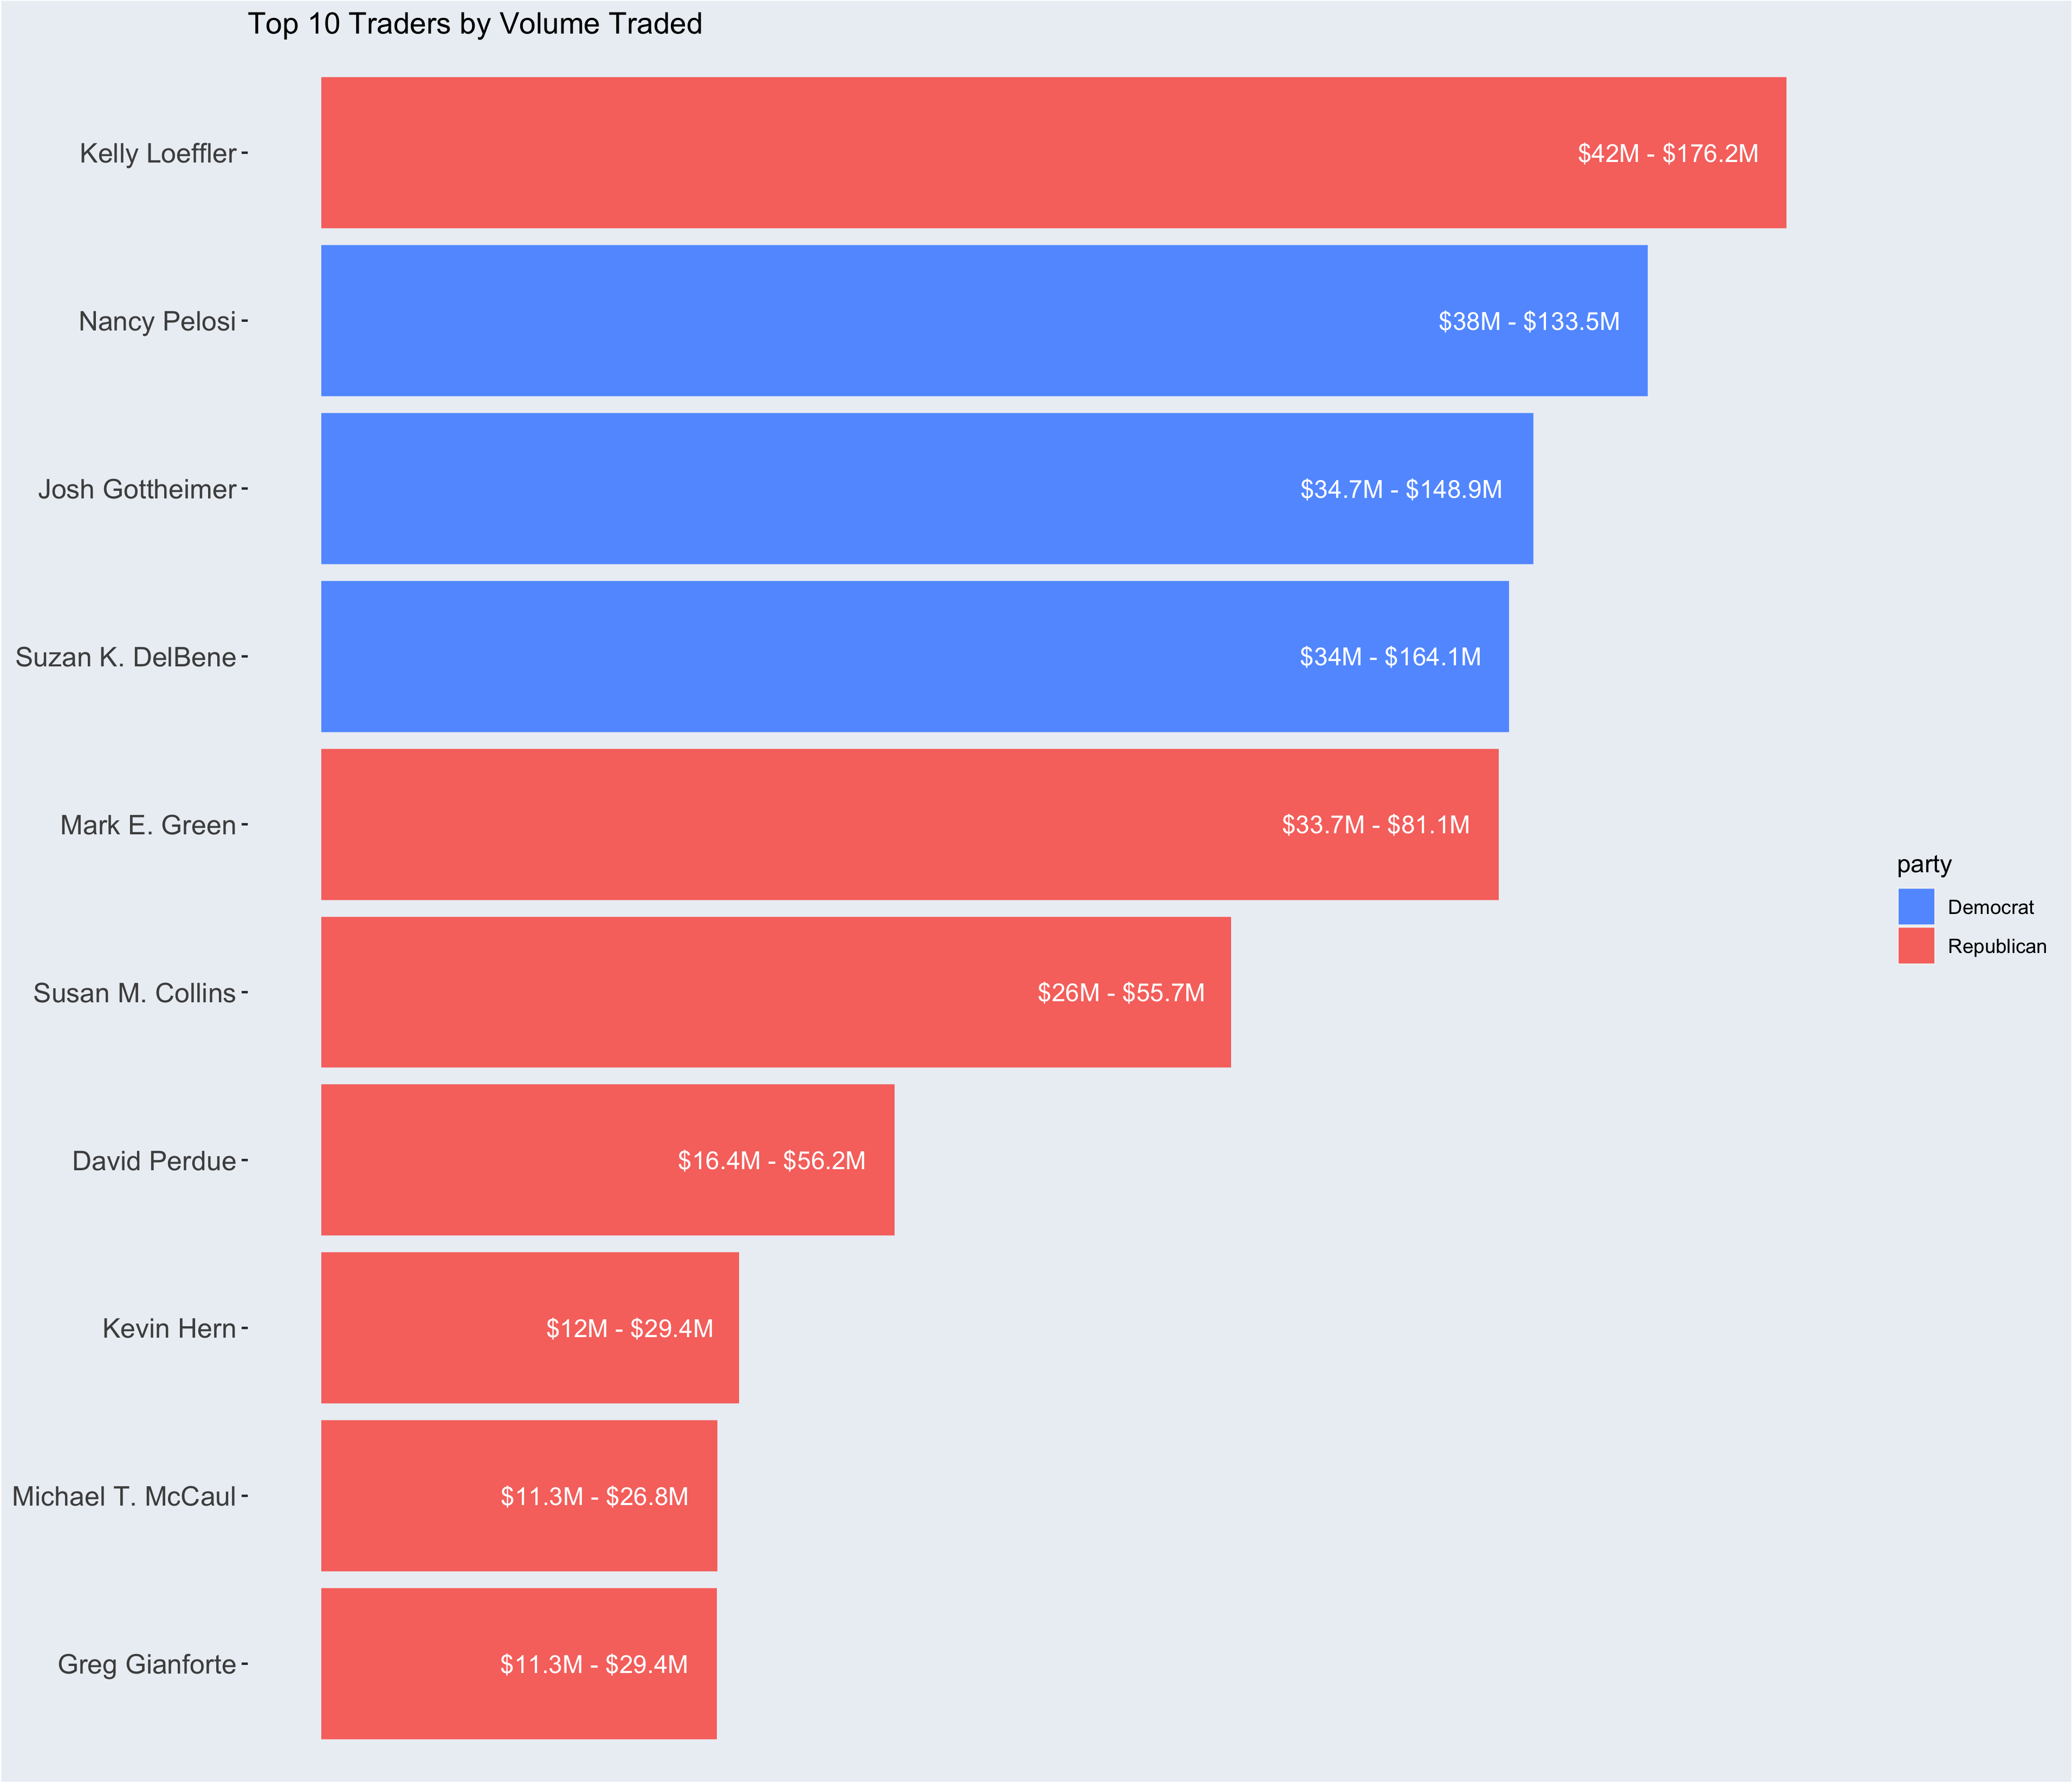
Top Traders (volume)
Notes:
Another metric to assess is who are the big players of the congress stock trading game.
This was extremely shocking to see.
There are congresspeople, who are trading in volumes of the $10’s of Millions, just over the past 9 years.
They are moving around A LOT of money.
Kelly Loefler is moving the most money around: at least $42 million over the past 9 years.
What I’m trying to do is notice similar names across all of these metrics, And So far Mark Greene from TN was on the previous list for being timely with his trades with an average delay aaf 14 days and on this chart for moving at least $33M in stocks over the past 3 years.

Slide 20
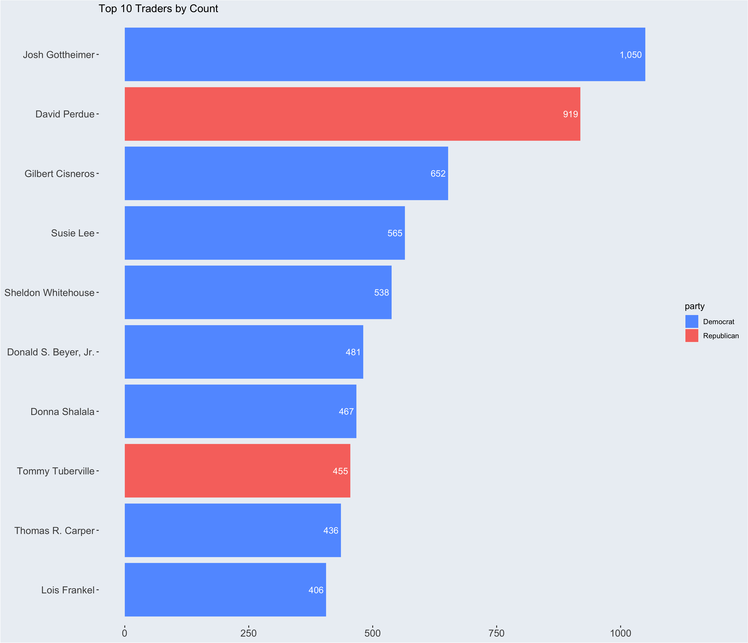
Top Traders (count)
Notes:
Here is the same chart as the previous slide, but assessed in # of trade volume.
I see Donna Sshalala, but she was one of the Slowest to report so I wouldn’t look to her for advice.
NEXT

Slide 21
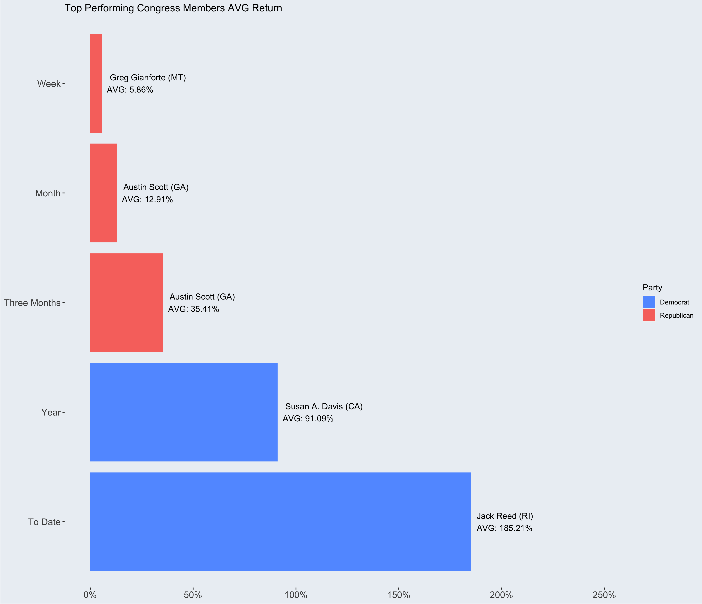
Top Average Returns
Notes:
Lastly
Just as I did with the government as a whole, I want too assess the performance of the individuals ability to time the market.
I’ll start with this chart which provides the largest average returns per time period.
In this specific case, I removed all sell data and only focused on buy data just to get a clear metric.
Here we some very extreme results for averages.
To average a 5% return one week after all your transactions is quite a feat.
TALK THROUGH THE REST OF THE RESULTS
NEXT

Slide 22
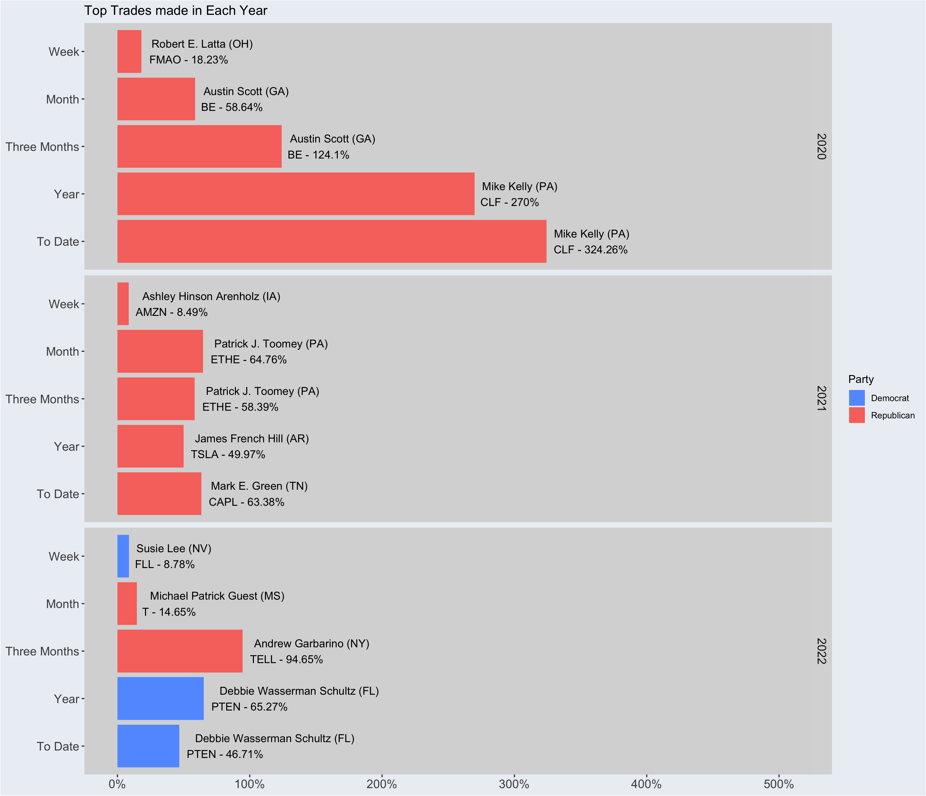
Top Trades(per year)
Notes:
LASTLY I wanted to see the TOP Trades mad in each time period in every year.
TALK THROUGH RESULTS
MARK E GREENE 2021 to_date

Slide 23

DC Trades
Congress Stocks Trading Shiny App

Slide 24

Future Ideas
Append the senate committees
Attached to SQL Database for increased Efficiency
Live Data pulled from API
Create custom Twitter Alerts based on Congress Members

Slide 25
Thank you!

